Slide 1
PHY 712 Electrodynamics
10-10:50 AM MWF Olin 103
Lecture 30: Continue reading Chap. 14 – (Especially 14.6)
Radiation by accelerating charged particles –
particularly the analysis of of synchrotron radiation
Review of the basic equations
Detailed analysis of synchrotron radiation generated from man-made facilities
Synchrotron radiation from astronomical sources
Notes:
In this lecture, we will continue discussing the material presented in Chap. 14 of Jackson’s textbook on the subject of radiation from accelerating charged particles.

Slide 2
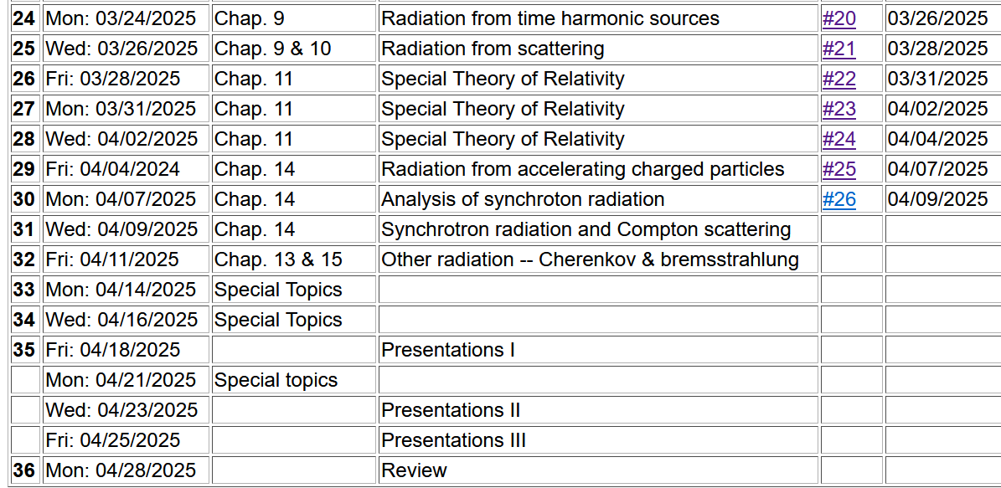

Slide 3
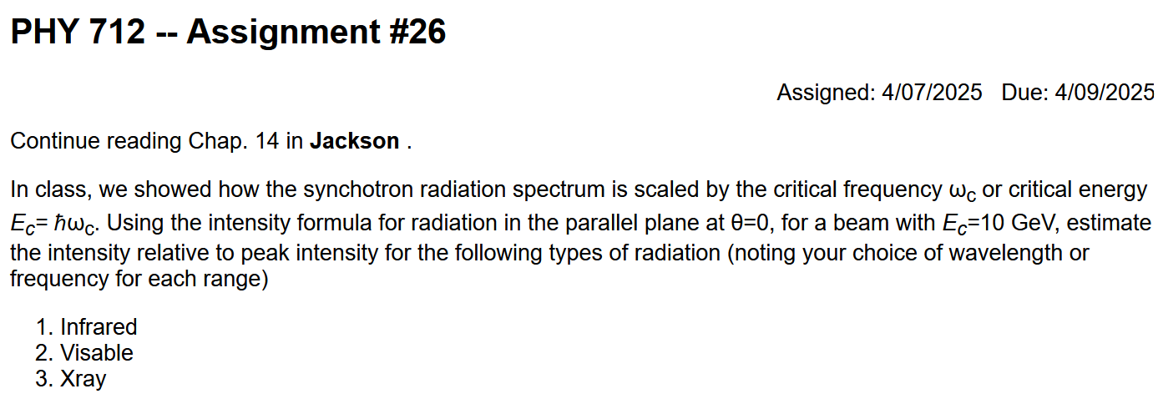

Slide 4
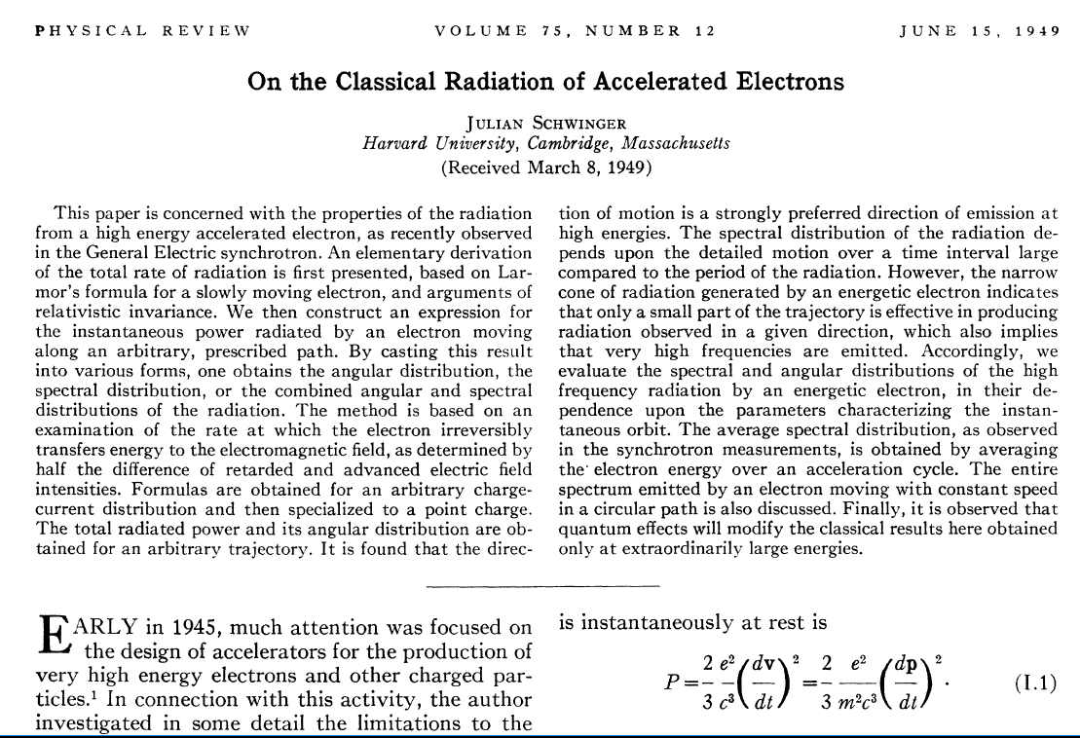
The results discussed in today’s lecture come from the following 1949 paper of Julian Schwinger --
Notes:
This famous paper by Julian Schwinger discusses some of the details presented on these slides.

Slide 5
Radiation from a moving charged particle analyzed by Liénard-Wiechard --
z
r-R_{q}(t)
q
r
R_{q}(t)
y
x
Notes:
Here is the general diagram we have been using to denote the field point r and the trajectory R_q(t).

Slide 6
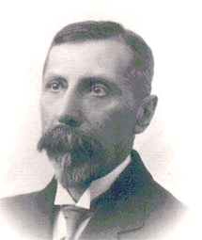
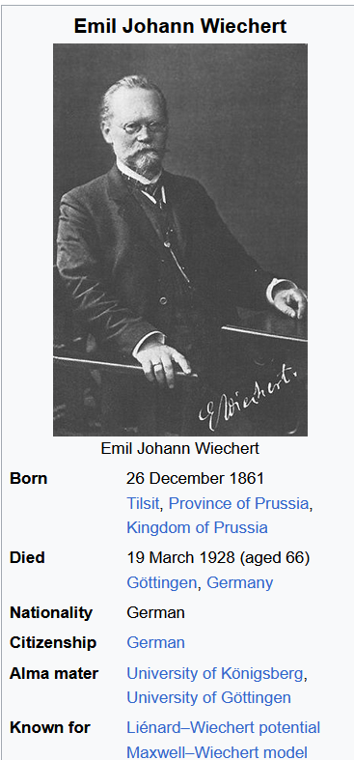
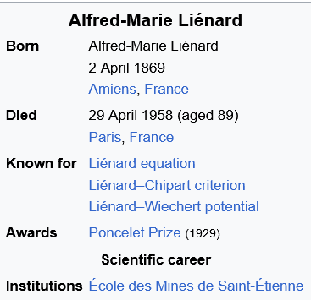

Slide 7
From Liénard-Wiechard analysis, the electric and magnetic fields far from source are given by --
Note that all of the variables on the right hand side of the equations depend on t_{r} .
Notes:
Specializing the equations to fields in the radiation zone.

Slide 8
Poynting vector:
Notes:
Evaluating the Poynting vector for the radiation zone.

Slide 9
Power radiated
Notes:
The general expression for the power per unit solid angle.

Slide 10
Spectral composition of electromagnetic radiation
Previously we determined the power distribution from
a charged particle:
Notes:
Now we will return to the power measured with respect to the field time (as opposed to the retarded time). In this way will be able to use the beautiful mathematics of Fourier transforms to analyze the spectral properties of the radiation. Here we imagine that the radiation is measured at a given location for a long period of time so that we will want to evaluate the time integrated power W.

Slide 11
Spectral composition of electromagnetic radiation -- continued
Parseval’s theorem
Marc-Antoine Parseval des Chênes 1755-1836
http://www-history.mcs.st-andrews.ac.uk/Biographies/Parseval.html
Notes:
Here we make use of the Parseval’s theorem which allows us to relate the time integral of the power to the frequency integral of its Fourier transform.

Slide 12
Spectral composition of electromagnetic radiation -- continued
Notes:
Mathematically, the theorem involves integrals over all frequencies, while physically negative frequencies are not measured. By using the fact that the power amplitude must be real (mathematically), we can then derive a formula for the intensity I as a function of frequency and solid angle.

Slide 13
Spectral composition of electromagnetic radiation -- continued
Notes:
Here we analyze the power amplitude in order to take its Fourier transform. Apparently, if we can evaluate this integral, we can determine the intensity spectrum.

Slide 14
Spectral composition of electromagnetic radiation -- continued
Notes:
The integral must be performed over the field time, but the argument of the integral is expressed in terms of the retarded time. Fortunately, we can use the relationship between the two in order to perform the actual integral in terms of the retarded time.

Slide 15
Spectral composition of electromagnetic radiation -- continued
Notes:
Here we make use of some approximations valid far from the source.

Slide 16
Spectral composition of electromagnetic radiation -- continued
Notes:
Summarizing the approximations.

Slide 17
➔Spectral form of radiation far from source:
Notes:
In the last lecture, we attempted a simple example. Here we will jump into the synchrotron case directly.

Slide 18
Spectral composition of electromagnetic radiation – more detailed treatment --
Notes:
We will evaluate this expression for synchrotron radiation.

Slide 19
Some details --
0

Slide 20
More details

Slide 21
Spectral composition of electromagnetic radiation -- continued
Notes:
Summary of equations that need to be avaluated.

Slide 22
Specific evaluation for particle moving in a circular path at a constant speed v --

Slide 23
z
r
.
θ
β
y
β
Top view:
x
ρ
y
x
Notes:
Setup of the coordinate system to analyze the particle trajectory. Here rho denotes the circular radius and v denotes the particle speed (assumed to be constant).

Slide 24
z
r
.
θ
β
y
β
x
Notes:
For this analysis we will assume that the radiation is detected in the x-z plane. The angle theta is defined with respect to the x axis. Two polarization vectors denoted with epsilonparallel and epsilonperpendicular (both perpendicular to r) are defined.

Slide 25
z
r
.
θ
β
y
β
x
Notes:
Here the two amplitudes C for parallel and perpendicular polarizations are defined in terms of the trajectory parameters.

Slide 26
Notes:
Following Jackson’s derivations, we arrive at the expression given on the slide that is equivalent to Jackson’s Eq. 14.79. The two terms represent the two different polarization contributions. Both terms are expressed in terms of Bessel function of the third kind of order 1/3 or 2/3.

Slide 27
Some details:
Modified Bessel functions
Exponential factor
Notes:
Here are some of the details. It is assumed that the integrands are dominated by contributions for tr near 0, theta near 0 and speeds v close to the speed of light.

Slide 28
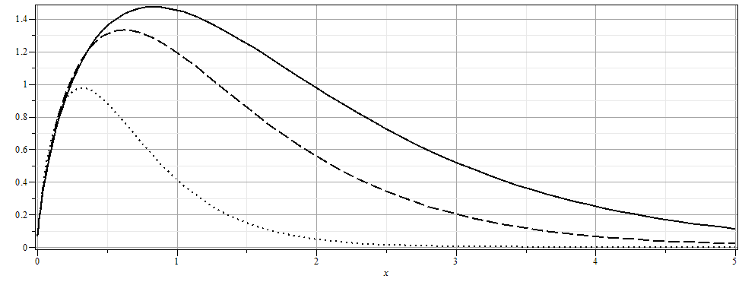
Notes:
From the expression, we can plot the intensity as a function of the scaled frequency scaled by the critical frequency defined on the previous slide for various angles theta.

Slide 29
More details
Notes:
More plots. The fact that the frequency scales with the critical frequency means that by designing facilities with different radii and gamma factors, the spectral range can be controlled.

Slide 30
Why assume
The above analysis applies to a class of man-made facilities dedicated to producing intense radiation in the continuous spectrum. For more specific information on man-made synchrotron sources, the following web page is useful: http://www.als.lbl.gov/als/synchrotron_sources.html.

Slide 31
Synchrotron radiation light source installations
Synchrotron at Brookhaven National Lab, NY
E_{c}= 3 GeV X-ray radiation
https://www.bnl.gov/ps/
Notes:
This is an arial photo of the facility on Long Island, NY.

Slide 32
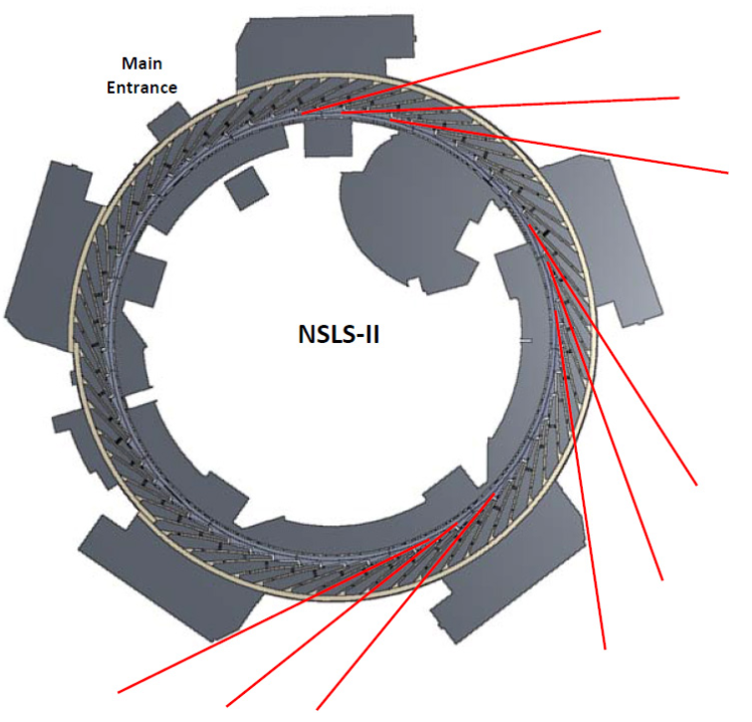
Spectrometer and sample
Notes:
Diagram showing the positioning of the experimental ports in red where the radiation from the circulating electrons is used.

Slide 33
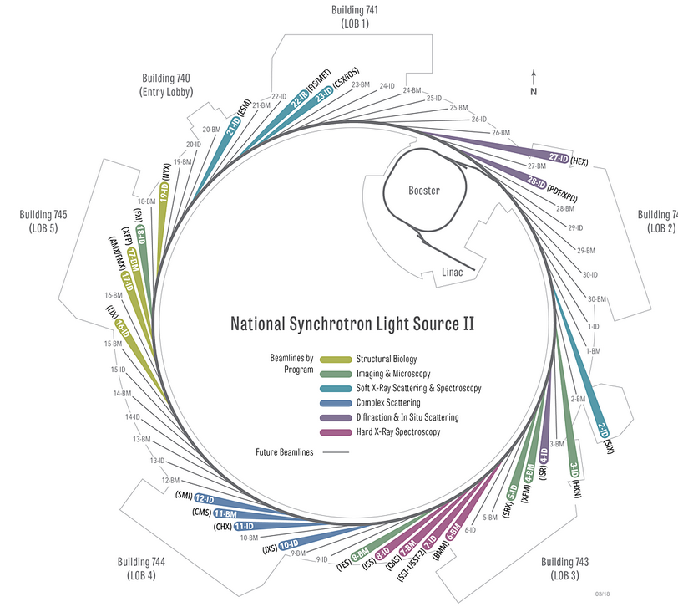
Overview of developed beamlines.
Notes:
More detail with indications of particular experiments.

Slide 34
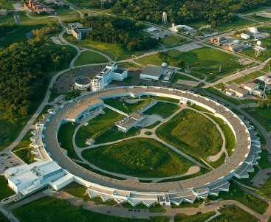
Advanced photon source, Argonne National Laboratory
https://www.aps.anl.gov/
Notes:
Arial photo of the facility of Argonne National Laboratory

Slide 35
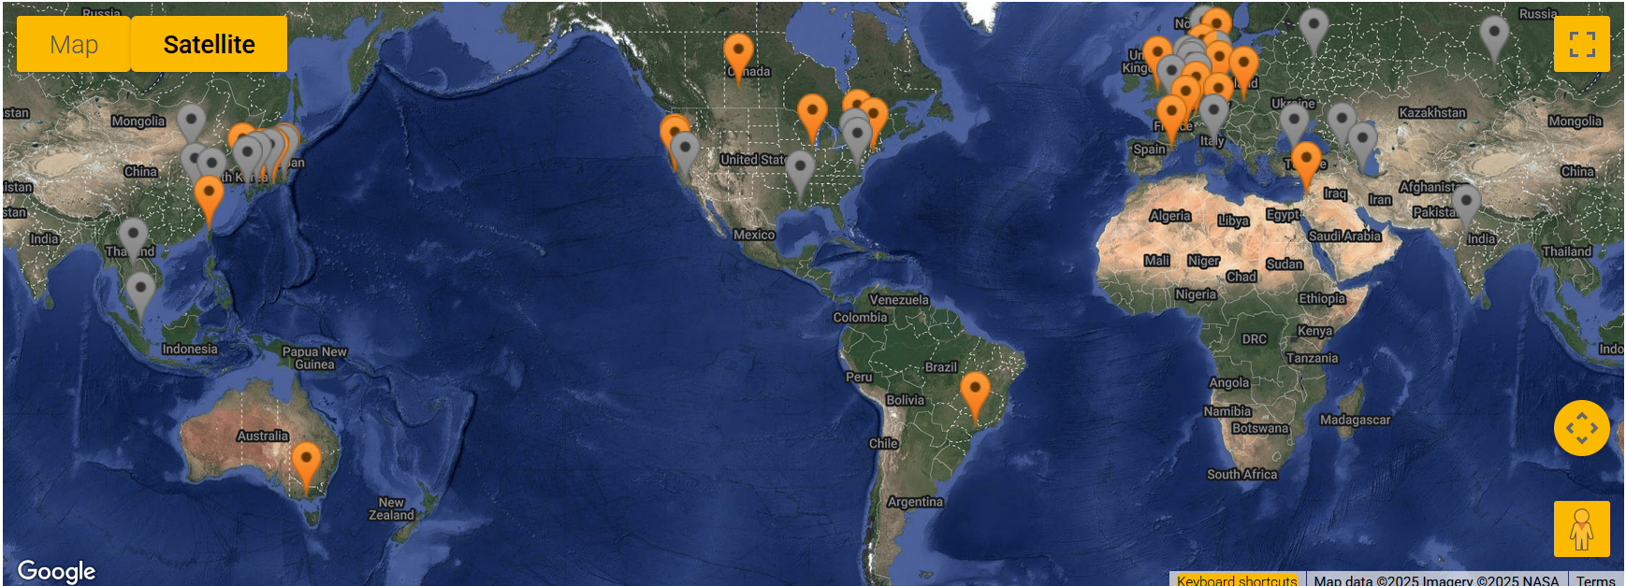
https://lightsources.org/lightsources-of-the-world/

Slide 36
The second example of synchrotron radiation comes from a distant charged particle moving in a circular trajectory such that the spectrum represents a superposition of light generated over many complete circles. In this case, there is an interference effect which results in the spectrum consisting
of discrete multiples of v/ρ. For this case we need to reconsider the analysis. There is a very convenient Bessel function identity of the form:
Notes:
Now consider another geometry for synchrotron radiation from charge particles in outer space moving in circular orbits due to magnetic fields for example. The equations are still true. We can analyze those equations using the given identity involving a series of Bessel functions.

Slide 37
Astronomical synchrotron radiation -- continued:
Notes:
Some details are listed here.

Slide 38
Astronomical synchrotron radiation -- continued:
In both of the expressions, the sum over m includes both negative and positive values. However, only the positive values of ω and therefore positive values of m are of interest. Using the identity: the
result becomes:
These results were derived by Julian Schwinger (Phys. Rev. 75, 1912-1925 (1949)). The discrete case is similar to the result quoted in Problem 14.15 in Jackson's text.

