Slide 1
PHY 712 Electrodynamics
10-10:50 AM MWF Olin 103
Notes for Lecture 31:
Radiation by moving charges
Continue reading Chap. 14 – (Sec. 14.1-14.8 in JDJ)
Recap of synchrotron radiation
Some other radiation sources
Compton scattering
Notes:
In this lecture, we will continue discussing the material presented in Chap. 14 of Jackson’s textbook on the subject of radiation from moving charged particles.

Slide 3
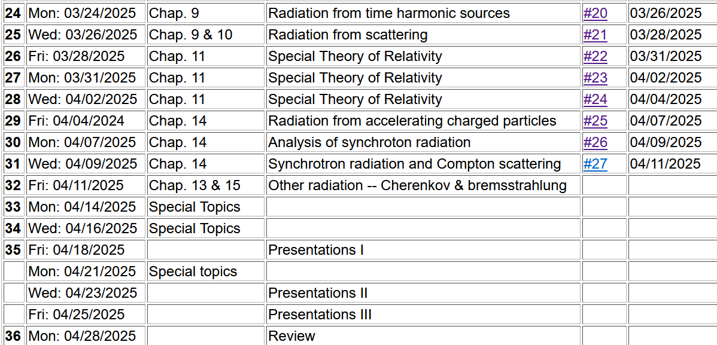

Slide 4
Signup for 2025 PHY 712 presentations

Slide 6
Comment about units
e measured in Statcoulombs
Length measured in cm
Energy measured in ergs
e measured in Coulombs
Length measured in m
Energy measured in joules (J)
Also note that:
1 J=6.24150907446076 x 10¹⁸ eV
Some results concerning synchrotron radiation --

Slide 7
z
r
.
θ
β
y
β
Top view:
x
ρ
y
x
Notes:
Setup of the coordinate system to analyze the particle trajectory. Here rho denotes the circular radius and v denotes the particle speed (assumed to be constant).

Slide 8
z
r
.
θ
β
y
β
x
Notes:
For this analysis we will assume that the radiation is detected in the x-z plane. The angle theta is defined with respect to the x axis. Two polarization vectors denoted with epsilonparallel and epsilonperpendicular (both perpendicular to r) are defined.

Slide 9
z
r
.
θ
β
y
β
x
Notes:
Here the two amplitudes C for parallel and perpendicular polarizations are defined in terms of the trajectory parameters.

Slide 10
Solution appropriate for man-made synchrotron facilities
Notes:
More plots. The fact that the frequency scales with the critical frequency means that by designing facilities with different radii and gamma factors, the spectral range can be controlled.

Slide 11
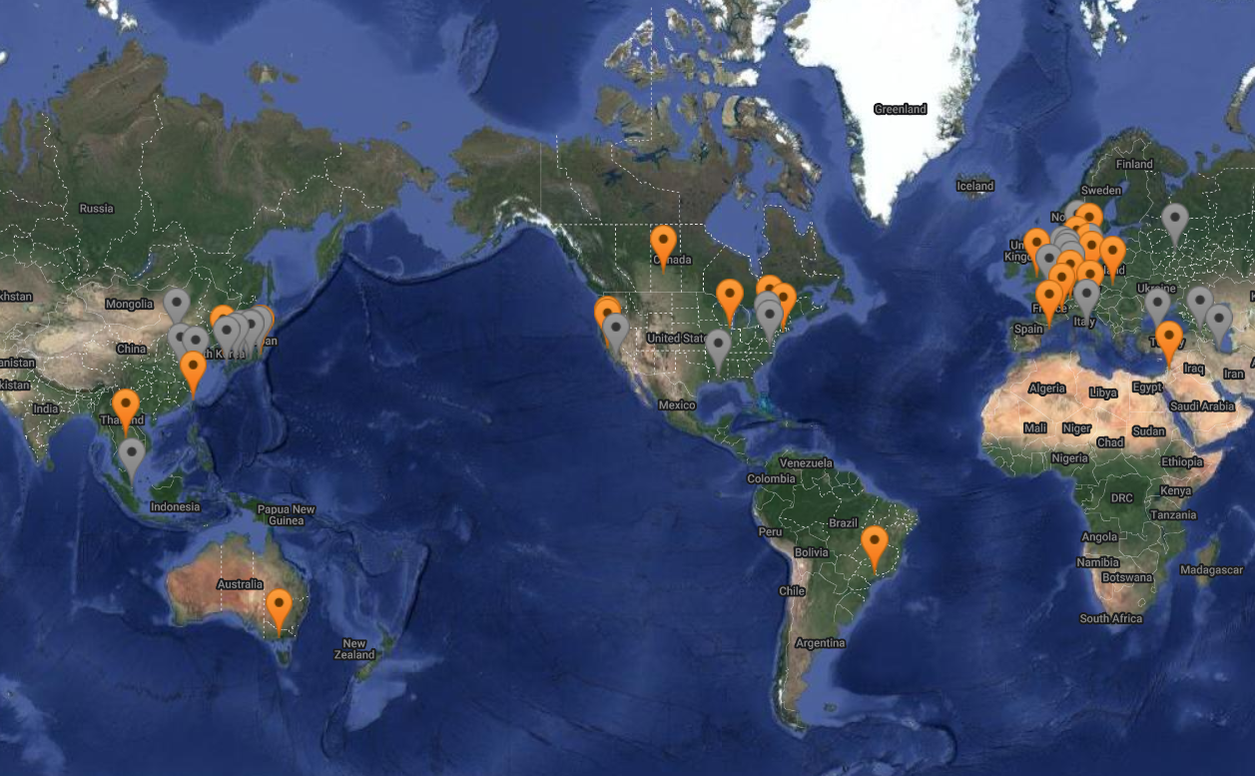
https://lightsources.org/lightsources-of-the-world/

Slide 12
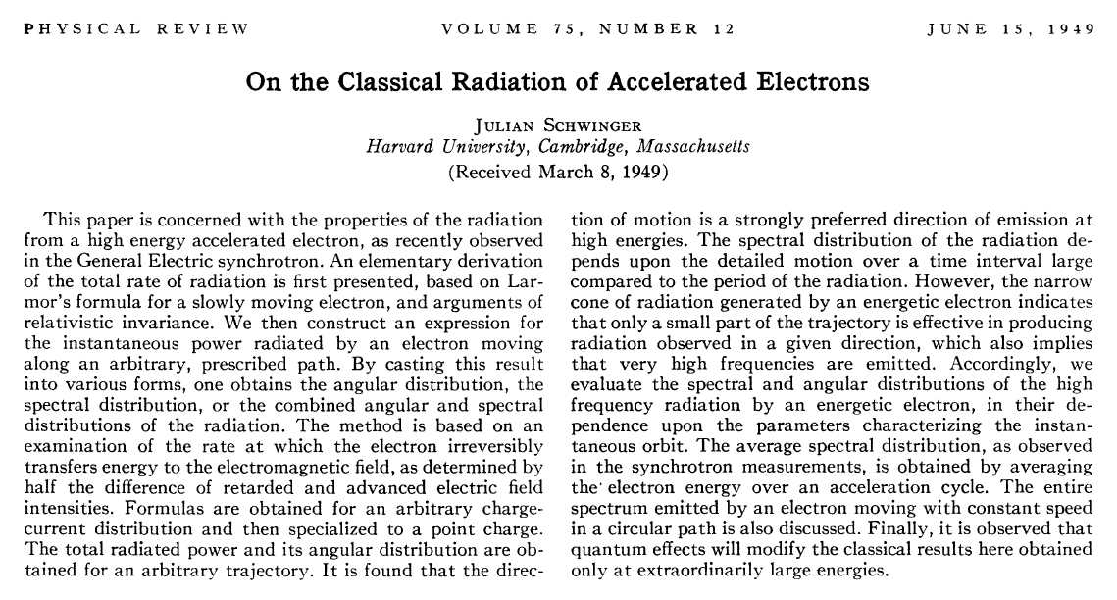
Synchrotron radiation is also produced by astronomical sources as analyzed by Julian Schwinger –
DOI:https://doi.org/10.1103/PhysRev.75.1912

Slide 13
z
Recalling general results of analysis --
r
.
θ
β
y
β
x
It is possible to perform the full time integral analytically.
Notes:
Here the two amplitudes C for parallel and perpendicular polarizations are defined in terms of the trajectory parameters.

Slide 14
Useful identity involving Bessel functions
Notes:
Some of the identities repeated from last time.

Slide 15
Some details for last step --
Notes:
Some of the identities repeated from last time.

Slide 16
Astronomical synchrotron radiation -- continued:
Notes:
More details.

Slide 18
Astronomical synchrotron radiation -- continued:
In both of the expressions, the sum over m includes both negative and positive values. However, only the positive values of ω and therefore positive values of m are of interest. Using the identity: the
result becomes:
These results were derived by Julian Schwinger (Phys. Rev. 75, 1912-1925 (1949)). The discrete case is similar to the result quoted in Problem 14.15 in Jackson's text (with θ→θ+π/2).
Notes:
Comment on the relevance of the results.

Slide 19
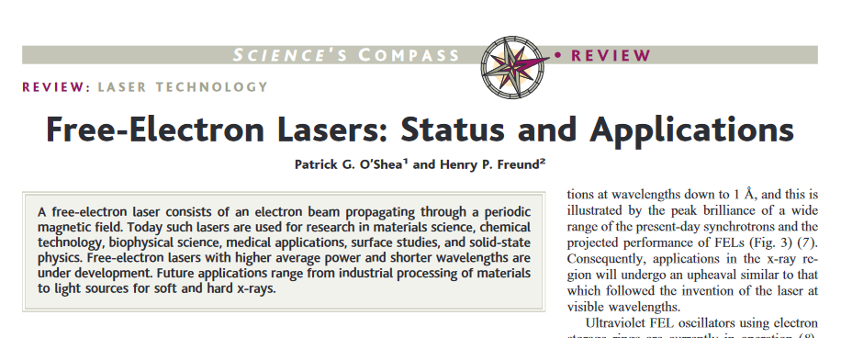
Comment on light source facilities and the newer free electron laser technology
DOI: 10.1126/science.1055718

Slide 20
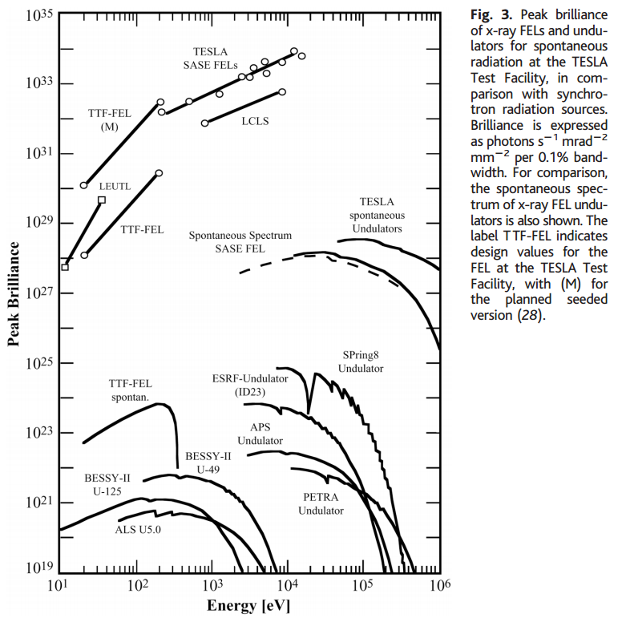
Notes:
Data from a review article on Free Electron Lasers

Slide 21
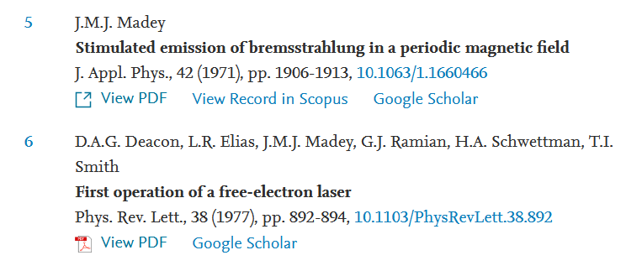
Additional references on Free Electron Lasers
https://doi.org/10.1016/j.xinn.2021.100097

Slide 22
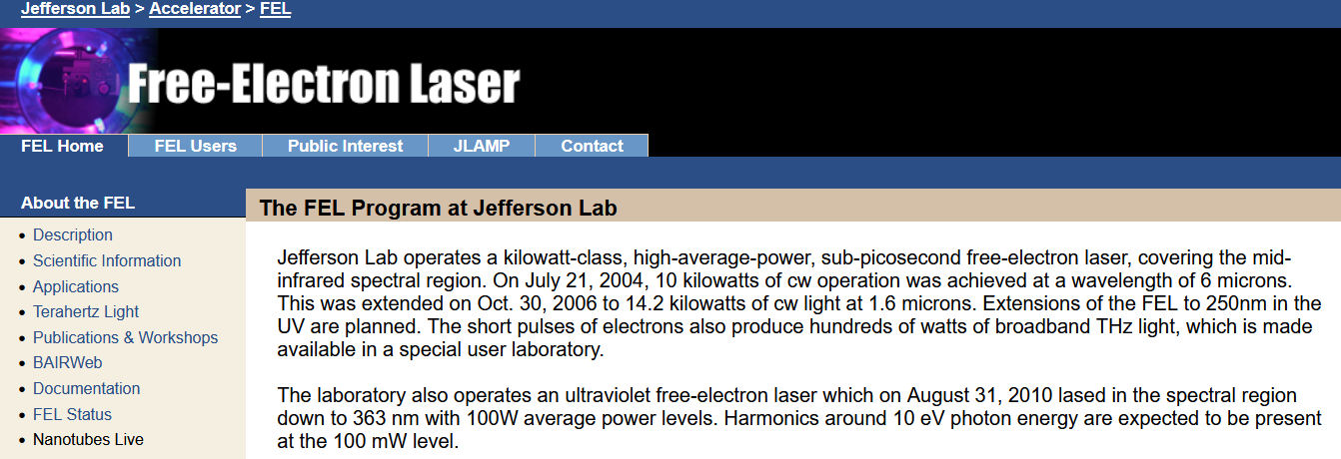
Components of the FEL
Electrons moving in circular path segments
Self-amplified spontaneous emission (SASE)
Often designed for the X-ray range
Jefferson Free Electron Laser Lab in VA is designed in the microwave←→infrared range
https://www.jlab.org/FEL/felspecs.html

Slide 23
Back to fundamental processes – Thompson and Compton scattering (see section 14.8 in Jackson)
Some details of scattering of electromagnetic waves incident on a particle of charge q and mass m_{q}
r
k₀
θ
ε₂
ε₀
φ
ε₁
Notes:
For next time.

Slide 24
Thompson scattering -- classical picture
Some details of scattering of electromagnetic waves incident on a particle of charge q and mass m_{q}
r
k₀
θ
ε₂
ε₀
φ
ε₁
Notes:
Consider the effects of a charged particle encountering an electromagnetic wave.

Slide 25
Thompson scattering – non relativistic approximation
Notes:
The power generated in the far field approximated by the non-relativistic limit, is given here. Now we consider that the particle acceleration is due to the oscillating electric field. The power of the radiation of the particle is then given here.

Slide 26
What assumptions are made to conclude that
Is it always true?

Slide 27
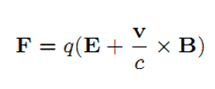
Comment on acceleration
Lorentz force:

Slide 28
Thompson scattering – non relativistic approximation -- continued
z
r
k₀
θ
ε₂
y
ε₀
φ
x
ε₁
Are these polarizations unique?
Notes:
By evaluating the radiation geometry, we can determine the power distribution.

Slide 29
Note that we are associating the vector
with the polarization of the light. Why?
Liénard-Wiechert fields (cgs Gaussian units):

Slide 30
Thompson scattering – non relativistic approximation -- continued
z
r
k₀
θ
ε₂
y
ε₀
φ
x
ε₁
Notes:
The radiated field is polarized perpendicularly to the propagation direction so that the power depends on the dot product of radiation polarization and the incident polarization.

Slide 31
Thompson scattering – non relativistic approximation -- continued
z
r
k₀
θ
ε₂
y
ε₀
φ
x
ε₁
Notes:
Evaluating the dot products for this geometry.

Slide 32
Thompson scattering – non relativistic approximation -- continued
Scattered light may be polarized parallel to incident field or polarized with an angle θ so that the time and polarization averaged cross section is given by:
This formula is appropriate in the X-ray scattering of electrons or soft γ-ray scattering of protons
Notes:
Summary of results in the non-relativistic limit.

Slide 33
Thompson scattering – relativistic and quantum modifications
p’_{q}
incident photon
α
p
θ
p’
scattered
photon
04/08/2013
33
Notes:
When the photon energy is comparable to the rest mass energy of the charged particle, we have to consider momentum and energy conservation. This was ferst analyzed by Compton. Your homework asks you to examine the Compton scattering relationships.

Slide 35
In fact, the more accurate treatment by Klein and Nishina
gives

Slide 36
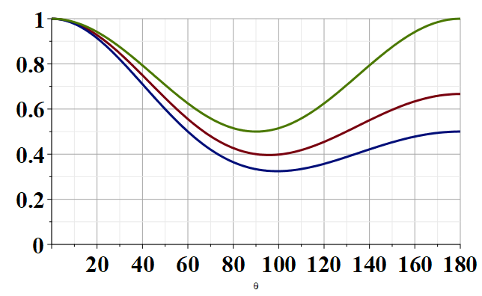
Modified Thompson scattering cross section
θ
Notes:
Plot of the changes to the Thompson cross section due to the Compton effect.

