Slide 1
PHY 712 Electrodynamics
10-10:50 AM MWF Olin 103
Discussion for Lecture 32:
    Including topics from Chaps. 13 & 15 in JDJ
      1. Radiation from collisions of charged particles
        X-ray tube
        Radiation from Rutherford scattering
      2. Cherenkov radiation
Notes:
In this lecture we will discuss some examples of radiation due to charged particles colliding. It is a complicated topic which quite a few famous physicists have worked on. We will also briefly discuss Cherenkov radiation.

Slide 2
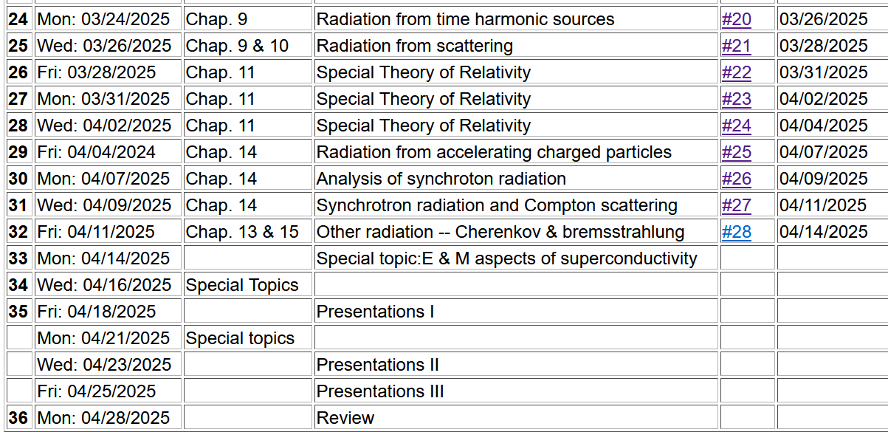
Notes:
This is the revised schedule, subject to your input.

Slide 3
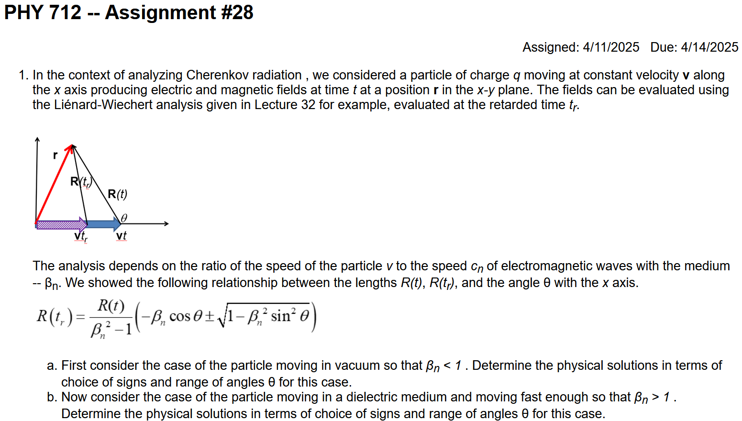

Slide 4
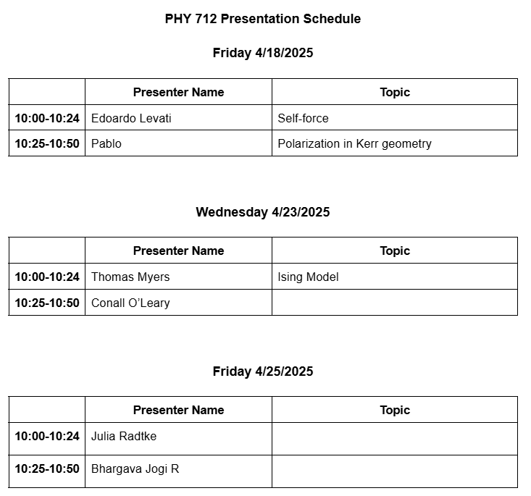

Slide 5
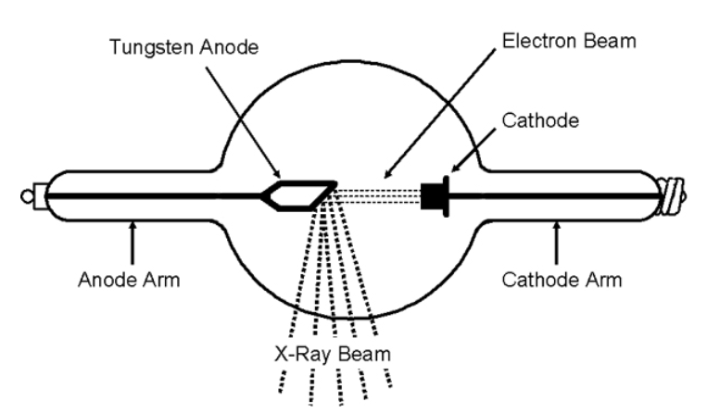
Generation of X-rays in a Coolidge tube
https://www.orau.org/ptp/collection/xraytubescoolidge/coolidgeinformation.htm
Invented in 1913. Associated with the German word “bremsstrahlung” – meaning breaking radiation.

Slide 6
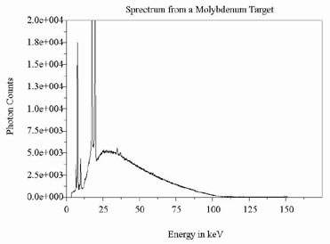
http://www.ndt-ed.org/EducationResources/CommunityCollege/Radiography/Physics/xrays.htm
Quantum effects – due to the resonant excitation of electrons from core states of Mo

Slide 7
Radiation during collisions of charged particles
These ideas are presented in Chapter 15 of JDJ and were developed by many famous scientists during the early 1900’s.
β
−β(t)
Δβ
r
θ
β(t)
β(t+Δt)
φ
Δβ
Notes:
Starting from the intensity analysis for radiation due to a charged particle moving in a trajectory with beta representing its velocity/c. We will consider the velocity changing due to a collision process and analyze the radiation at small frequencies.

Slide 8
Results from previous analyses:
Note that in the following slides we are taking the limit ω→0
but keeping the notation of the differential intensity….
Note that ε is perpendicular to r.

Slide 9
Radiation during collisions -- continued
In the limit β→0, this is the same as the non-relativistic case.
Notes:
For beta<<1, we can neglect the denominator of the expression and obtain the non-relativistic expression. It is also convenient to analyze the relativistic case when the change in velocity is small.

Slide 10
Radiation during collisions -- continued
β
r
θ
φ
Δβ
polarization in r and β plane
polarization perpendicular to r and β plane
Notes:
It is convenient to consider two different polarizations of the radiation – parallel (meaning in the plane of the observation point r and the initial velocity of the particle) and perpendicular (meaning perpendicular to that plane).

Slide 11
Some details:
β
(using geometry of Fig. 15.2 in Jackson)
r
θ
φ
Δβ
Note: This is a wild assumption!
Notes:
Showing the detailed geometry of the scattering process.

Slide 12
Consistent with
radiation from charged particles.
Convenient geometry
Wild guess
Notes:
Evaluating the vectors.

Slide 13
z
Radiation during collisions -- continued
β
r
θ
y
φ
Δβ
x
Notes:
It is possible to analytically integrate over all solid angles.

Slide 14
Notes:
Some details of the analysis. With all of these considerations, we still need to estimate delta beta.

Slide 15
Need to consider the mechanics of collision; it is convenient to parameterize in terms of momentum --
Estimation of Δβ
q
Δβ
q
β(t)
β(t+Δt)
mass of particle having charge q
What are the conditions for the validity of this result?

Slide 16
What are possible mechanisms for the momentum transfer Q?

Slide 17
Estimation of Δβ or Q -- for the case of Rutherford scattering
q
Δβ
q
β(t)
β(t+Δt)
Ze
p’
θ’
Q
p
Notes:
Delta beta will depend on the particular system. As an example, consider the case of Rutherford scattering.. Here are some of the equations we used in classical mechanics class.

Slide 18
Case of Rutherford scattering -- continued
q
p(t+Δt)
θ’
Q
Ze
p(t)
Does the algebra work out?
Notes:
It is convenient to express the results in terms of the momentum transfer Q.

Slide 19
Case of Rutherford scattering -- continued
q
p(t+Δt)
θ’
Q
Ze
p(t)
Notes:
It is of interest to estimate the probability of the radiation occurring which depends on the product of the radiation intensity for a given momentum transfer and the cross section as a function of momentum transfer.

Slide 20
How do the limits of Q occur?
Jackson suggests that these come from the limits of validity of the analysis.
Seems like cheating?
Perhaps fair?
Notes:
But we are not done. Thinking of the case of the charged particle moving through the target material, there will be a range of momentum transfers that should be integrated as indicated here. Note that we have assumed that the frequency of the radiation is very small. Here we consider how frequency might ener this analysis.

Slide 21
Comment on frequency dependence --
Here τ is the effective collision time.

Slide 22
How to estimate the collision time?
Jackson uses the following analysis in terms of the impact parameter b:

Slide 23
λ= “fudge factor” of order unity
Notes:
Hans Bethe considered this problem and also introduced a “correction” for quantum effects.

Slide 24
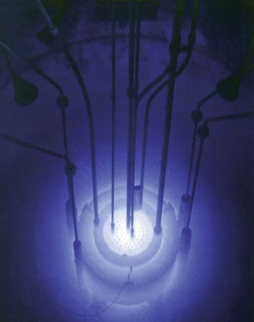
Cherenkov radiation
Cherenkov radiation emitted by the core of the Reed Research Reactor located at Reed College in Portland, Oregon, U.S.
Cherenkov radiation. Photograph. Encyclopædia Britannica Online. Web. 12 Apr. 2013. http://www.britannica.com/EBchecked/media/174732
Notes:
This is a view of Cherenkov radiation with its typical blue glow.

Slide 25
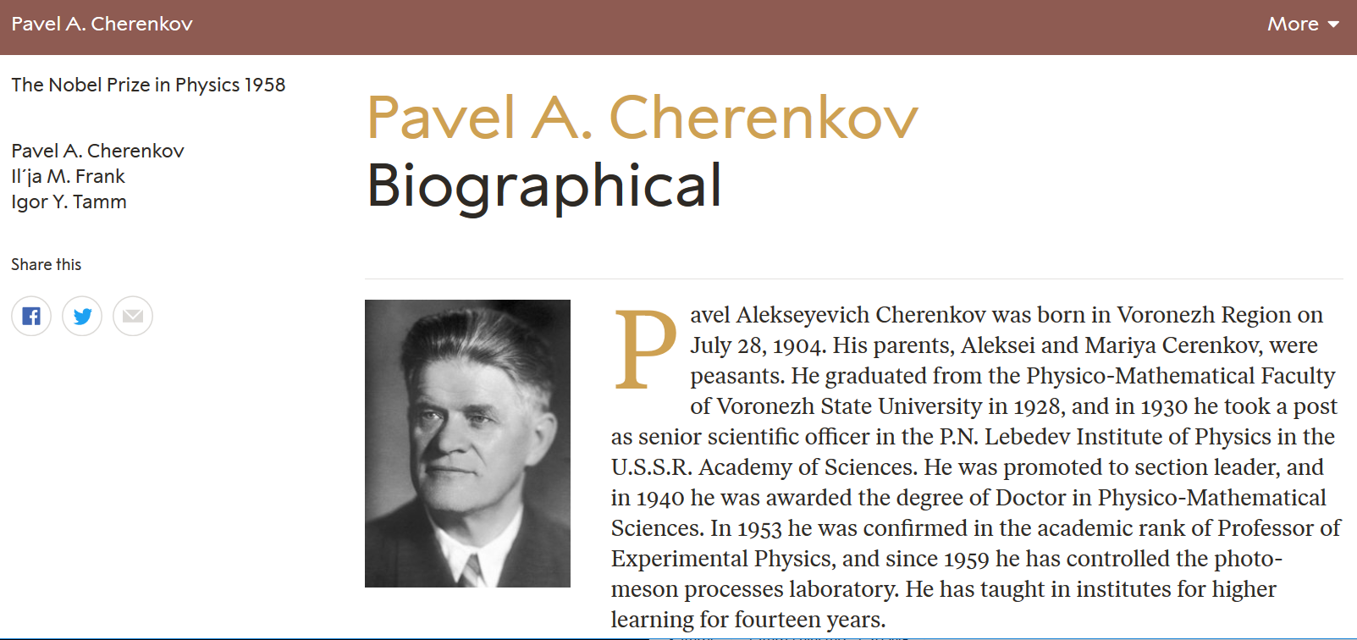
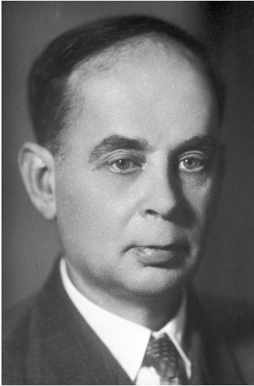
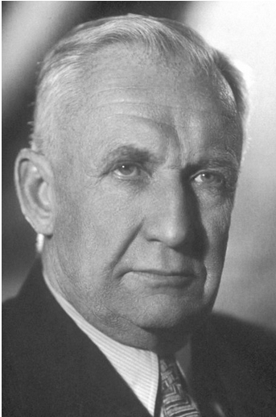
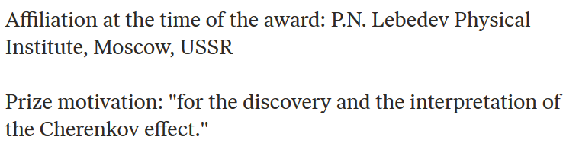
https://www.nobelprize.org/prizes/physics/1958/ceremony-speech/
Notes:
A Nobel prize was awarded for the discovery and explanation of this phenomenon.

Slide 26
References for notes: Glenn S. Smith, An Introduction to Electromagnetic Radiation (Cambridge UP, 1997), Andrew Zangwill, Modern Electrodynamics (Cambridge UP, 2013)
Cherenkov radiation
Discovered ~1930; bluish light emitted by energetic charged particles traveling within dielectric materials
Note that some treatments give a different definition of the critical angle θ_{c}
θ_{c}
q
Notes:
A diagram describing the phenomenon.

Slide 27
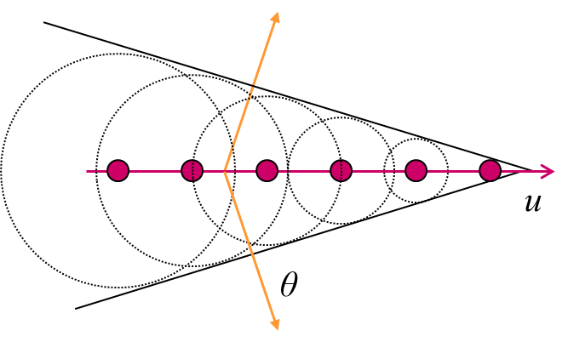
From: http://large.stanford.edu/courses/2014/ph241/alaeian2/
Electric field direction
Particle velocity
Notes:
Snapshots of the particle as it moves through the medium and of the wave fronts generated.

Slide 28
For v/c<1:
t_{r1}
v
t_{r3}
t_{r2}
t
(t-t_{r3})c
For v/c>1
(t-t_{r3})c
t_{r1}
v
t_{r3}
t_{r2}
t

Slide 29
Here the values of μ and ε depend on the material and on frequency.
R_{q}(t)
q
Notes:
Analysis of the scalar and vector potentials in the dielectric medium due to the particle of charge q.

Slide 30
Liénard-Wiechert potential solutions for charged particle moving within a material with refractive index n:
Notes:
Find the Lienard Wiechert solutions within the medium. Here, the major difference from previous solutions is that the wave speed c_{n} depends on the refractive index of the medium.

Slide 31
Which of these particles could produce Cherenkov radiation?
  A neutron with speed c?
  An electron with speed 0.6c?
  A proton with speed 0.6c?
  An electron with speed 0.8c?
  An alpha particle with speed 0.8c?
  None of these?

Slide 32
Further comment –
As discussed particularly in Chap. 13 of Jackson, a particle moving within a medium is likely to be slowed down so that the Cherenkov effect will only happen while β_{n}>1.

Slide 33
Recall – in Lecture 29, we considered a particle moving
at constant velocity v in vacuum:
y
y’
v
b
q
x
x’
z
z’
Electric and magnetic fields produced →

Slide 34
Some details for vacuum case --

Slide 35
For Cherenkov case --
r
R(t)
R(t_{r})
vt_{r}
vt
Notes:
For the vacuum case v<c, but not it is possible for v>c_{n}. Here we can solve the quadratic equation for the variables of the problem. The physical solution must be positive.

Slide 36
For β_{n}>1, how can the equality be satisfied?
  No problem
  It cannot be satisfied.
  It can only be satisfied for special conditions
Moreover, there are two retarded time solutions!

Slide 37
r
Original diagram:
R(t)
R(t_{r})
θ
vt_{r}
vt
r
What is the significance of changing the diagram?
New diagram:
R(t_{r})
R(t)
θ
vt_{r}
vt

Slide 38
r
R(t)
R(t_{r})
θ(t)
vt_{r}
vt
Notes:
Continuing the analysis for the variables needed to determine the scalar and vector potentials.

Slide 39
Recall the Liénard-Wiechert potential solutions:
Notes:
Find the Lienard Wiechert solutions within the medium. Here, the major difference from previous solutions is that the wave speed c_{n} depends on the refractive index of the medium.

Slide 40
Liénard-Wiechert potentials for two
solutions:
r
R(t)
R(t_{r})
θ(t)
vt_{r}
vt
Notes:
In order for the analysis to be consistent, cos(theta)<0 and sin(theta)<1/beta.

Slide 41
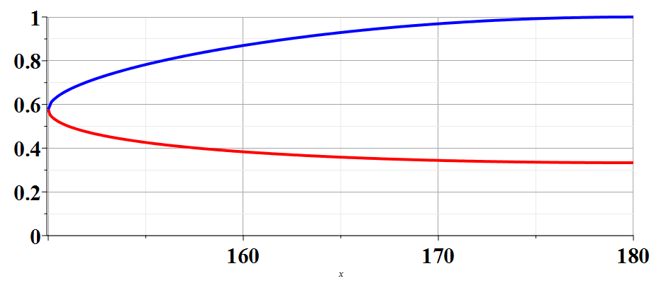
R(t_{r})/R(t)
β_{n}=2
150
θ
Notes:
Plot showing two solutions as a function of theta for a particular beta.

Slide 42
Physical fields for β_{n} > 1 -- two retarded solutions contribute
r
R(t)
R(t_{r})
θ(t)
vt_{r}
vt
Notes:
Here we use the Heaviside step function to ensure that the angle theta is in the correct range.

Slide 43
Physical fields for β_{n} > 1
Notes:
Summary of results for potentials and the corresponding electric and magnetic fields.

Slide 44
From these results, we need to generate the power spectrum – following the approach in Sec. 23.7 in Zangwill’s textbook.

Slide 45
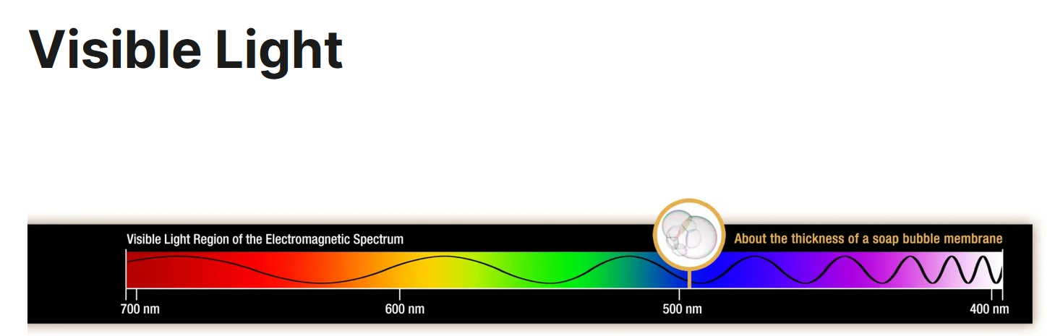
Wavelengths --
700 600 500

