Slide 1
PHY 712 Electrodynamics
10-10:50 AM MWF Olin 103
Notes for Lecture 33:
    Special Topics in Electrodynamics:
    Electromagnetic aspects of superconductivity
    Brief history
    Analysis by Fritz London
    Type I and type II superconductors
    Ideas from BSC theory
    Demo
Notes:
In this lecture we will discuss some of the aspects of superconductivity that involve electromagnetism, without getting into the quantum mechanical mechanisms.

Slide 2
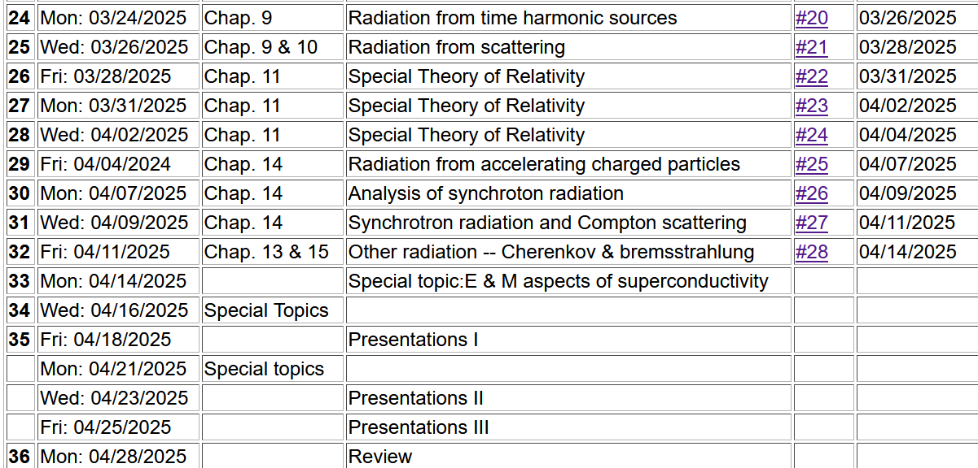

Slide 3


Slide 4
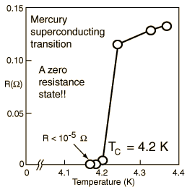
Special topic: Electromagnetic properties of superconductors
Ref:D. Teplitz, editor, Electromagnetism – paths to research,
Plenum Press (1982); Chapter 1 written by Brian Schwartz and Sonia Frota-Pessoa
History:
  1908 H. Kamerlingh Onnes successfully liquified He
  1911 H. Kamerlingh Onnes discovered that Hg at 4.2 K has vanishing resistance
  1957 Theory of superconductivity by Bardeen, Cooper, and Schrieffer
The surprising observation was that electrical resistivity abruptly dropped when the temperature of the material was lowered below a critical temperature T_{c}.
Notes:
These notes are partly based on the Teplitz textbook and other sources. Interestingly this is an example of a physical phenomenon stumping the theorists for nearly 50 years. The theorists are still arguing.

Slide 5
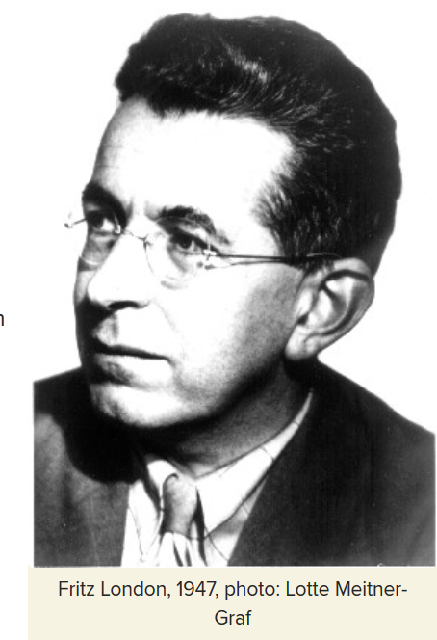
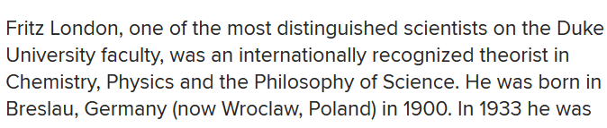
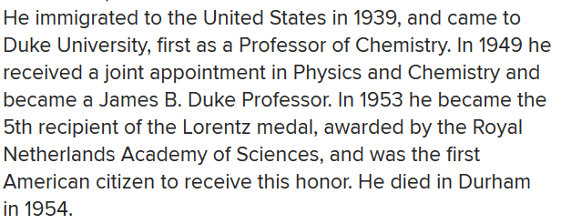
Fritz London 1900-1954
https://phy.duke.edu/about/history/historical-faculty/fritz-london
Notes:
The ideas we will discuss are largely due to Fritz London who developed a phenomenological theory before the microscopic materials mechanisms were developed by Bardeen, Cooper, and Schrieffer a few years after he died.

Slide 6
Some phenomenological theories < 1957 thanks to F. London
Note: Equations are in cgs Gaussian units.
Notes:
These equations represent models of idealized electrons in metals, starting with the Drude model which we previously discussed. The symbol tau represents a “relaxation” time; n represents the number density.

Slide 7
Properties of a normal metal
Does this model allow for any temperature dependence on the resistivity?
  No.
  Yes.
  Maybe.

Slide 8
How is the London model different from the Drude model?
  Subtle difference.
  Big difference.

Slide 9
Some phenomenological theories < 1957
Are these equations
  Exact?
  Approximate?
  Wrong?
Notes:
Following the logic of London’s equations. Here lambda which comes out of the analysis is a parameter with units of length.

Slide 10
London model – continued
Here we assume we know the boundary value at x=0.
Notes:
Fancy thinking with the time dependence. The result shows that the B field decays within the material within a distance lambda. Similarly, the current density also decays within the material.

Slide 11
London model – continued
λ_{L}
x
Notes:
The conclusion is that the current and magnetic field are excluded from the bulk of the superconductor; they are confined within a length lambda at the surface.

Slide 12
Behavior of superconducting material – exclusion of magnetic field according to the London model
λ_{L}
x
Notes:
Lambda is also called the London penetration length.

Slide 13
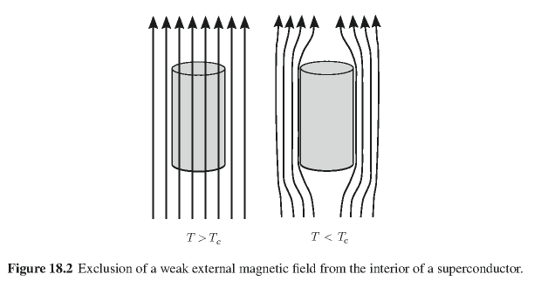
Behavior of magnetic field lines near superconductor
normal
state:
superconducting state:
Notes:
An illustration of the phenomenon in three dimensions.

Slide 14
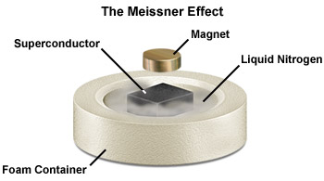
Notes:
Demonstration of the magnetic field effects when a small permanent magnetic is put above a superconducting magnetic. In this case the liquid N2 is needed to produce the superconducting phase of the material.

Slide 15
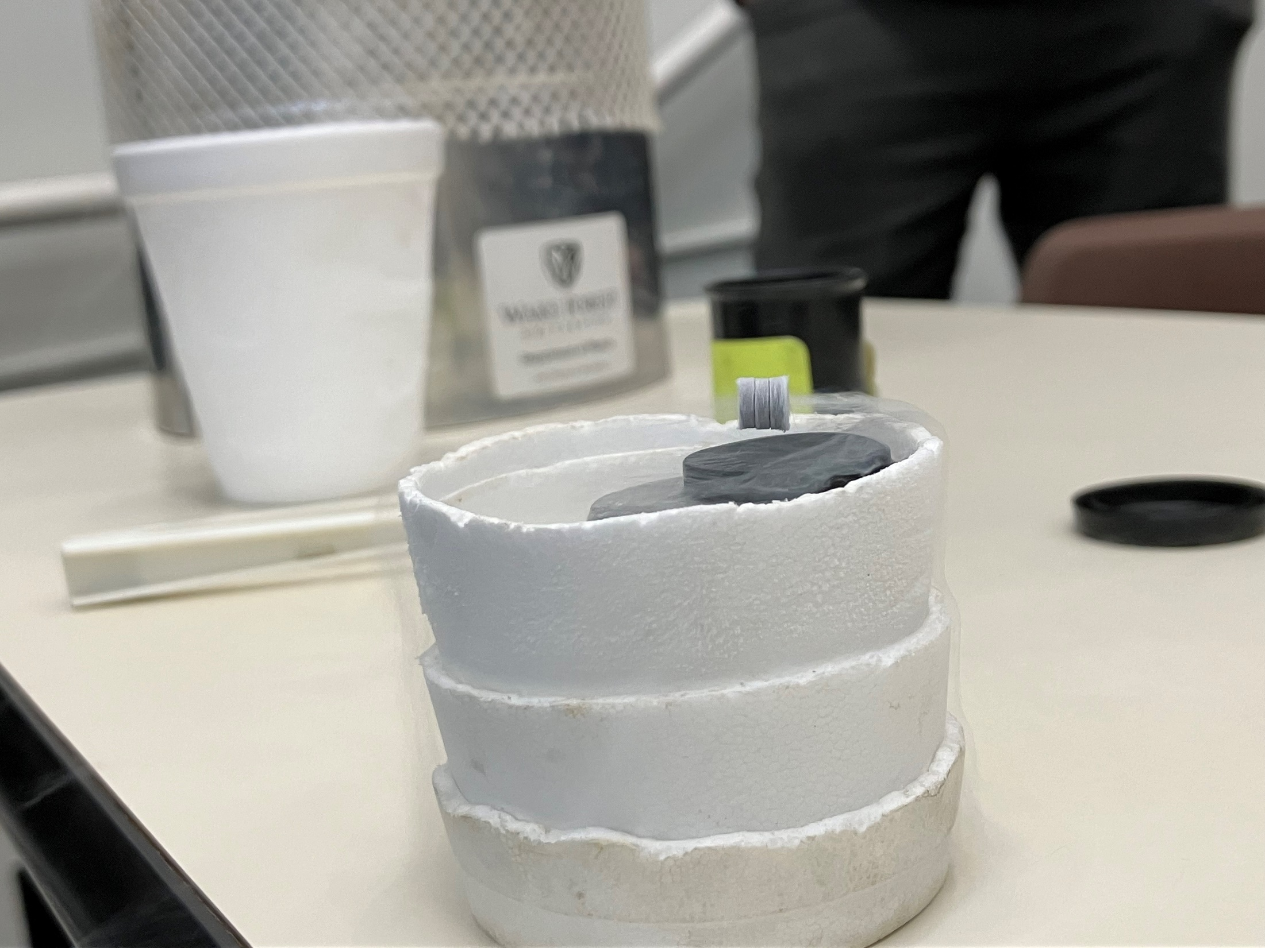

Slide 16
Need to consider phase equilibria between “normal” and superconducting state as a function of temperature and applied magnetic fields.
In practice, this is consistent with the analysis of London, assuming that within λ_{L} the surface current produces an opposing magnetic flux B.
Notes:
Interesting properties of the magnetization field of a superconductor.

Slide 17
Magnetization field
Here H is thought of in terms of an applied field.
At T=0K
Notes:
Here we need to consider thermodynamics of phase change. The Gibbs free energy of the superconducting state can be estimated. An applied magnetic field can raise the Gibbs free energy so that the superconducting phase is less favorable than the normal phase.

Slide 18

Magnetization field (for “type I” superconductor)
B
H
H_{C}
-4πM
H
H_{C}
G_{S}-G_{N}
H_{C}
H
Notes:
Plots of fields and Gibbs energy as a function of the applied field H.

Slide 19
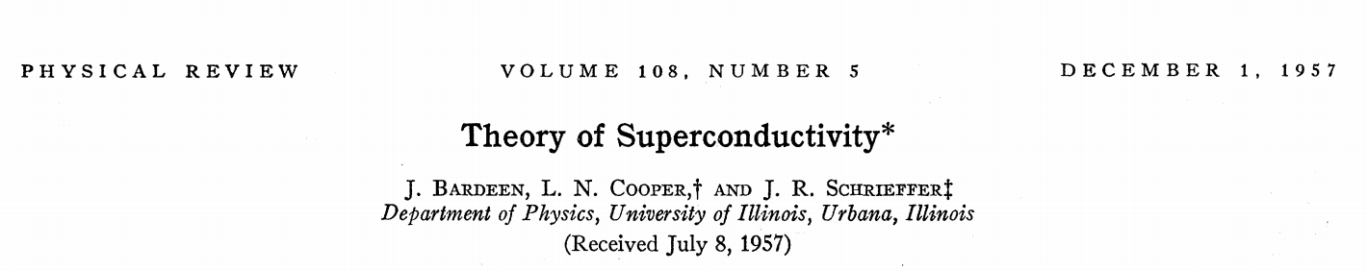
characteristic phonon energy
density of electron states at E_{F}
attraction potential between electron pairs
Notes:
Briefly, BCS theory estimated the energy of a superconductor relative to a normal metal at room temperature

Slide 20
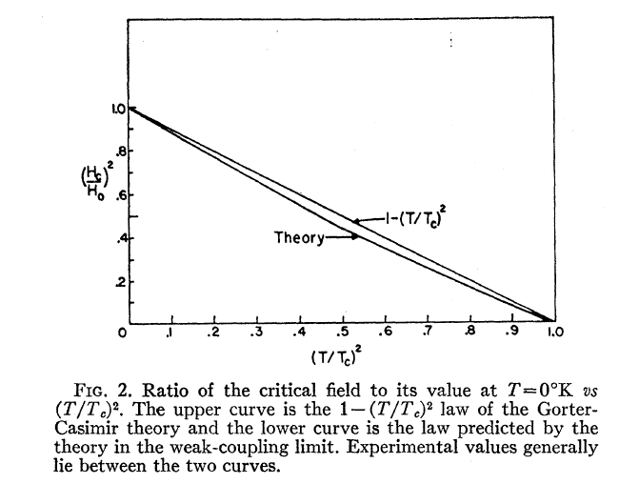
Temperature dependence of critical field
From PR 108, 1175 (1957)
  Bardeen, Cooper, and Schrieffer, “Theory of Superconductivity”
characteristic phonon energy
density of electron states at E_{F}
attraction potential between electron pairs
Notes:
The energy and critical field depends on temperature in a characteristic way predicted by the theory.

Slide 21
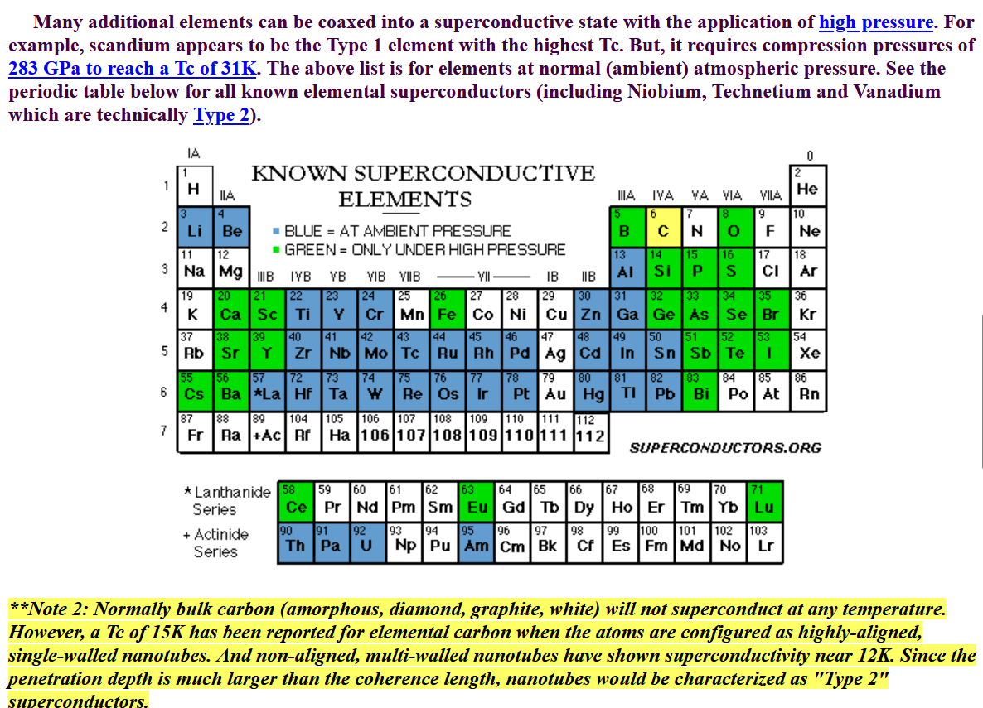
Type I elemental superconductors
http://www.superconductors.org/Type1.htm
Notes:
Some elemental super conductors.

Slide 22

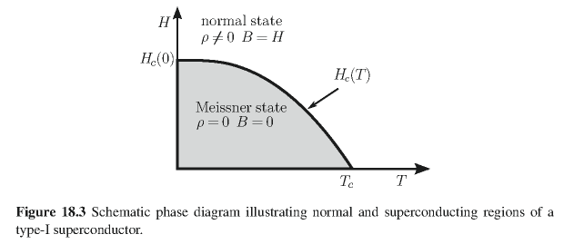
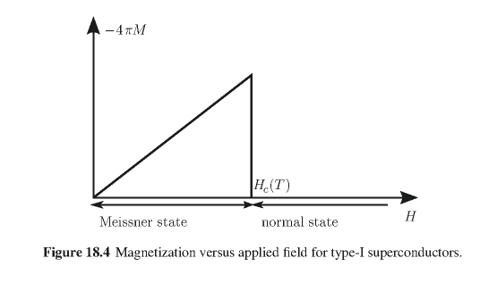
Type I superconductors:
Notes:
This discussion is relevant to “type I” superconductors.

Slide 23
The following slides give a quick look of some of the intriguing aspects of superconducting materials and their properties --

Slide 24
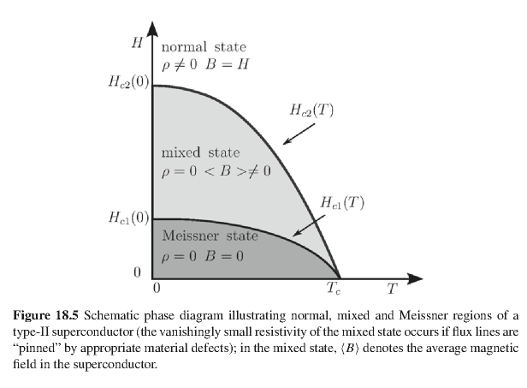
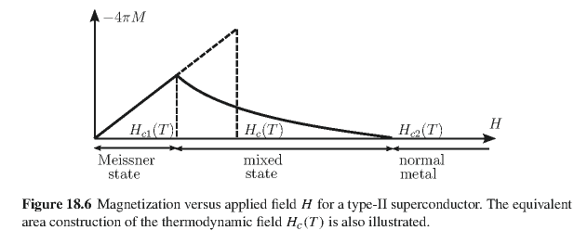
Type II superconductors
Notes:
Type II superconductors are more complicated. This model is more consistent with the so called high temperature superconductors.

Slide 25
Quantization of current flux associated with the superconducting state (Ref: Ashcroft and Mermin, Solid State Physics)
Notes:
Part of the story is that there can be (quantized) fields (vortices) within type II superconductors. This slide discusses some aspects of the currents.

Slide 26
Quantization of current flux associated with the superconducting state -- continued
Suppose a superconducting material has a cylindrical void. Evaluate the integral of the current in a closed path within the superconductor containing the void.
dl
Such “vortex” fields can exist within type II superconductors.
Notes:
The analysis follows from the notion that the wavefunction of the superconducting “particle” has a non-trivial phase factor.

Slide 27
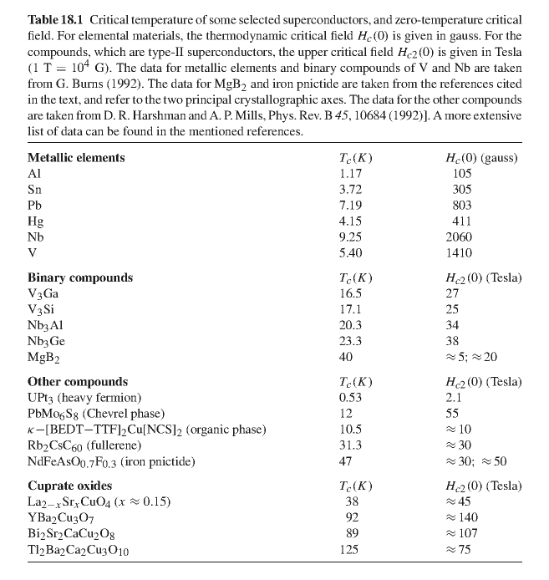
Notes:
Some superconducting materials listed on the web.

Slide 28
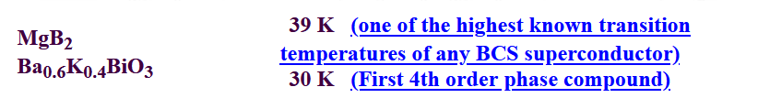
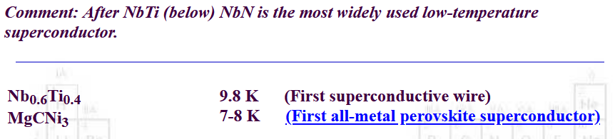
Some other notable type II superconductors –
(from www.superconductors.org)
Used in MRI machines

Slide 29
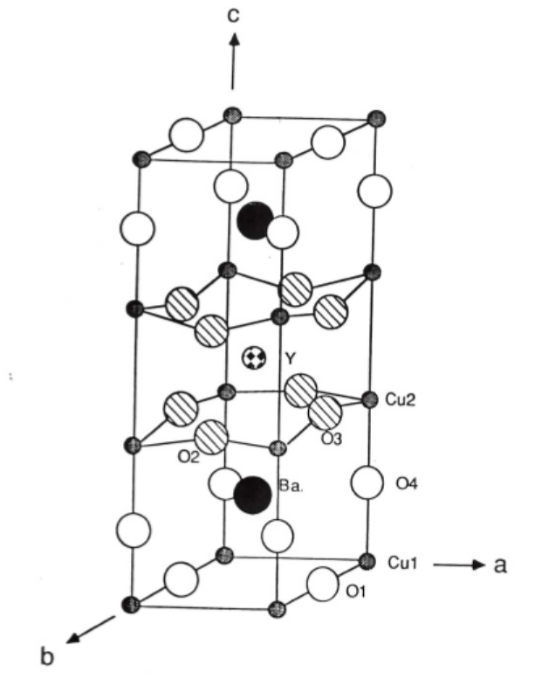
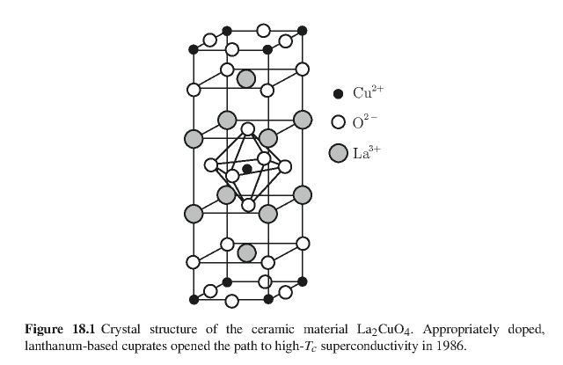
Crystal structure of one of the high temperature superconductors
YBa₂Cu₃O₇
From MS thesis of Brent Howe (Minn State U, 2014)
Notes:
One of the high temperature superconducting materials.

Slide 30
Some details of single vortex in type II superconductor
Notes:
Equations demonstrating that vortex solutions are consistent with London’s model.

Slide 31
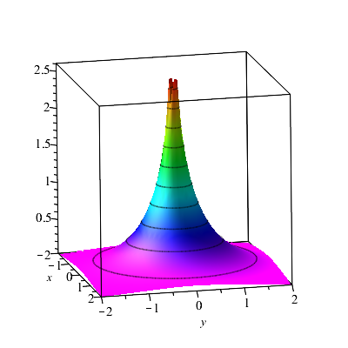
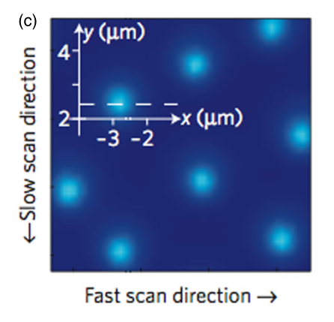
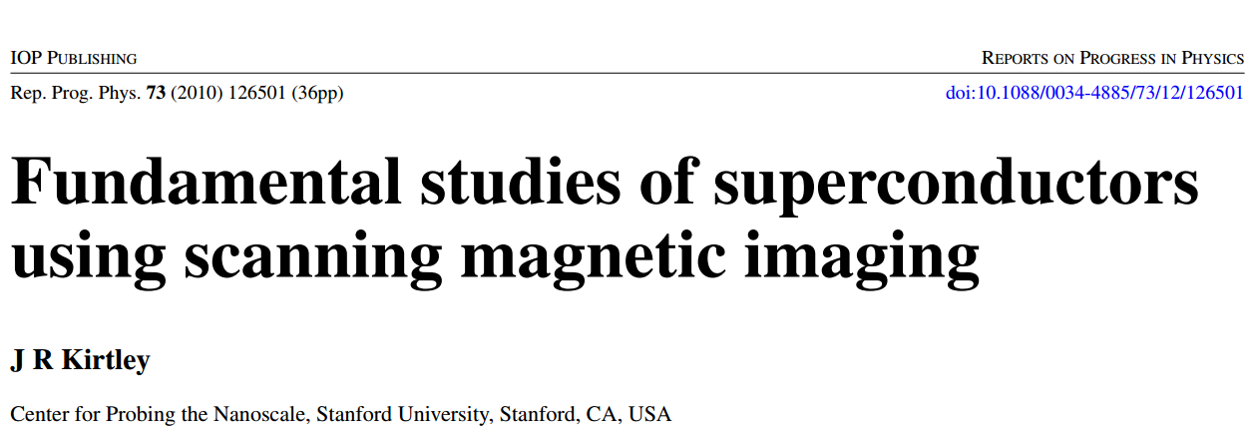
Scanning probe images of vortices in YBCO at 22 K
Based on physics of the Josephson junction.
Notes:
Scanning probe techniques can be used to visualize the magnetic vortices.

