Slide 1
PHY 712 Electrodynamics
10-10:50 AM MWF Olin 103
Notes for Lecture 34:
    Some quantum effects in electrodynamics
    Review of quantum eigenstates of electromagnetic Hamiltonian
    Connection between classical electromagnetic fields and Glauber’s coherent states

Slide 2
Physics colloquia this week
Thurs. April 17, 2025 — Master’s Defense: Mitch Turk — “MD SIMULATIONS OF TMAO INTERACTIONS WITH E.COLI 16S RIBOSOMAL RNA” –Olin 107, 9:00 AM (Advisor: Prof. S. Cho)
Thurs. April 17, 2025 — Ph.D. Defense: Trevor Jenkins — “MODELING VAN DER WAALS INTERACTIONS WITH DENSITY FUNCTIONAL THEORY” — ZSR 204, 12:00 PM (Advisor: Prof. T. Thonhauser)
Thurs. Apr. 17, 2025 — Professor Florian Mormann, University of Bonn — “Using Electricity in the Brain to Understand Human Memory” (Host: J. Macosko)

Slide 3
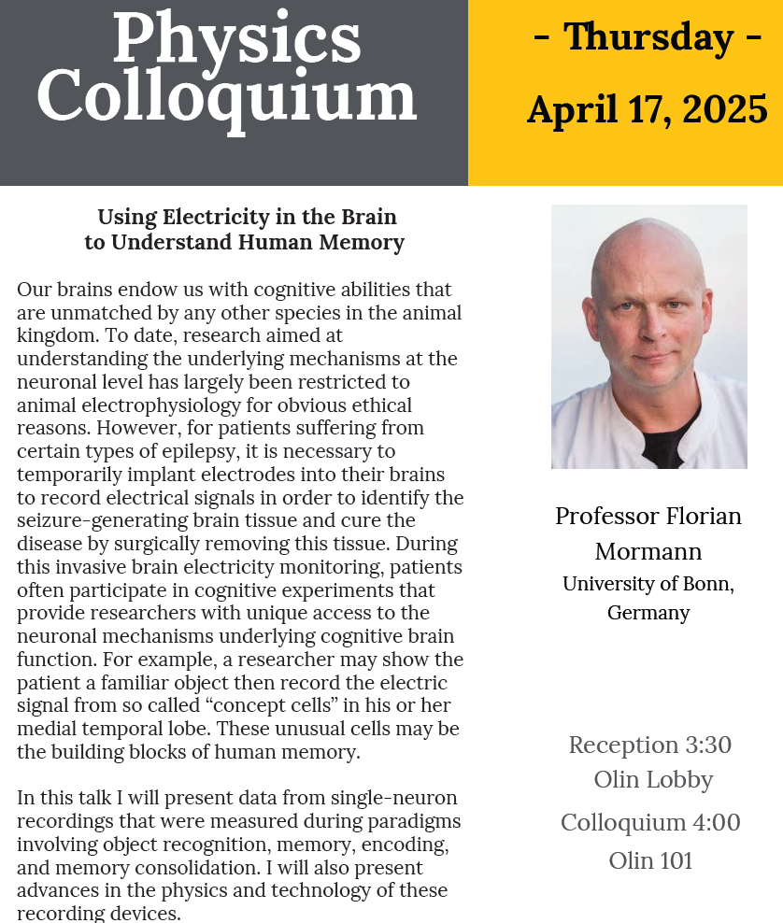

Slide 4
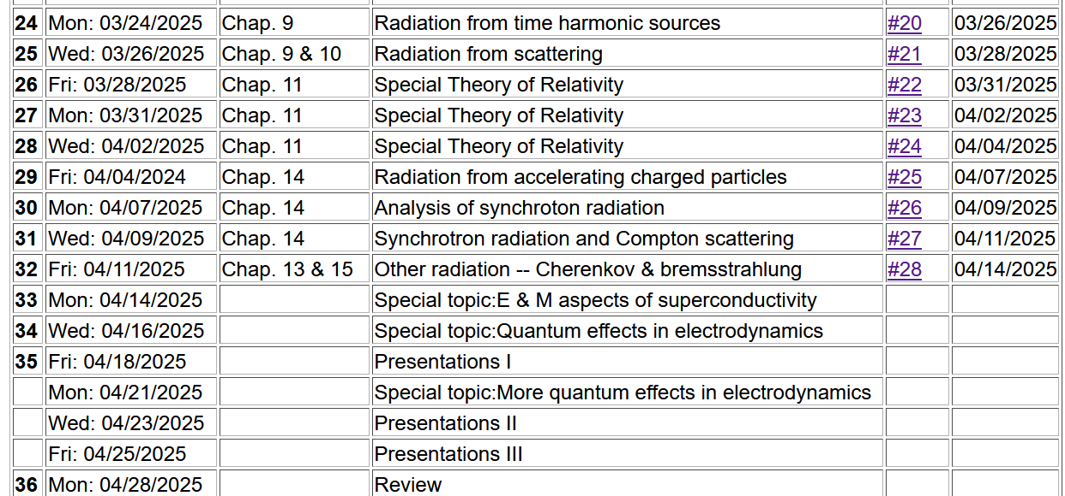

Slide 5
Quantization of the Electromagnetic fields
Reference – PHY 742 – Chapter 17
in Professor Carlson’s textbook
Review of the quantum harmonic oscillator
Hamiltonian for electromagnetic energy and its eigenstates
Properties of the quantized electromagnetic fields
Coherent states

Slide 6
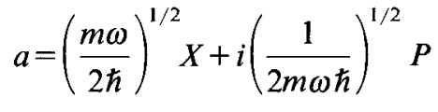

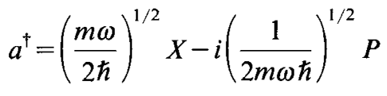
Review of one-dimensional quantum harmonic oscillator in terms of momentum P and displacement X with spring constant mω²
Note that:
Define:

Slide 7
Notes:
These results are derived in detail in Chapter V of Carlson’s text. Make sure that they make sense to you.

Slide 8
Contributing to the discussion –
  The creation and annihilation operators within the harmonic oscillator formalism seem to have been introduced by mathematical logic and found to have very interesting properties. In fact, as shown in Chapter 5, starting from the creation and annihilation operators, one can deduce the Harmonic Oscillator spectrum. These operators do not by themselves represent physical quantities and therefore do not “have” to be Hermitian. The matrix form of X and P in the basis of |n> is just one of many ways to represent these operators.
Further comments --
  The harmonic oscillator states clearly have an associated quantum number n. It is convenient to call n a “phonon number” for the moment. We will generalize this notion in the context of electromagnetic fields.

Slide 9
How does this beautiful formalism lead to the notion of creation and annihilation operators?
➔We can “create” any phonon state from the ground state with this operator.
Notes:
The relations on this slide have no new information, but lead to a different way of thinking of the eigenstates of our system. In particular, the last equation shows that you build up a state with n phonons from state with 0 phonons. Ultimately, this leads to mapping the |0> phonon state with “vacuum” and implies that you can create an n phonon state out of vacuum.

Slide 10
Extension of these ideas to multiple independent harmonic oscillator modes
Here 1,2,..i,j… denotes an arbitrary index referencing distinct modes.
Later, we will see how this formalism has the capability of keeping track of symmetry/antisymmetry properties of multi particle systems.
Notes:
Up to now we have considered an isolated harmonic oscillator. The ideas can be extended to consideration of multiple independent and non-interacting modes at once.

Slide 11
Favorite equations from classical electrodynamics
Maxwell’s equations
Back to SI units
Notes:
Now – to the matter at hand – we need to consider electromagnetic waves and therefore need to review classical electromagnetic theory.

Slide 12
Recall the electromagnetic field energy --
It will be convenient to express Maxwell’s equations and the
electromagnetic field energy in terms of scalar and vector potentials:
Notes:
Ultimately, we will need the Hamiltonian for electromagnetic phenomena, and this will come for the electromagnetic field energy. It is convenient to express this in terms of the vector potential.

Slide 13
Further manipulations of Maxwell’s equations in terms of scalar and vector potentials --
zero in Lorenz gauge
Notes:
Here we are interested in the electromagnetic waves far from their sources.

Slide 14
Equations within the Lorenz gauge --
Note that this is one of many possible choices and it turns out to be convenient.
Notes:
The final equation here is expressed purely in terms of the vector potential.

Slide 15
Plane wave solutions to electromagnetic waves in terms of vector potentials
3 mutually perpendicular vectors
These are unit polarization vectors.
Notes:
From the equations for the vector potential, we find that there are two plane wave solutions with two different polarizations as indicated by the index σιγμα.

Slide 16
General form of vector potential as a superposition of plane waves:
Notes:
You should make sure that you are in agreement with the derivation of these equations.

Slide 17
Summary --
Notes:
The final equation here is expressed purely in terms of the vector potential.

Slide 18
Some details, with more care to use real functions --
Notes:
Here are some details of the derivation.

Slide 19
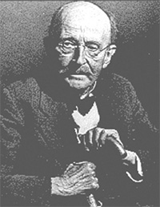
In the next slide, we will “jump” to quantizing the electromagnetic field using the analogy of the harmonic oscillator Hamiltonian. In fact, the analogy has nothing to do with the physics of the harmonic oscillator other than their particle symmetry as Bose particles.
Historical importance of the formula for Blackbody radiation
A blackbody means an idealized opaque (non-reflective) material which can absorb and emit electromagnetic radiation. If the body has an equilibrium temperature T, the energy associated with the blackbody is <U>. Using statistical mechanics and the assumption of quantized electromagnetic radiation, Planck showed that the black body internal energy and its distribution is given by in terms of frequency f:
Max Planck 1858-1947

Slide 20
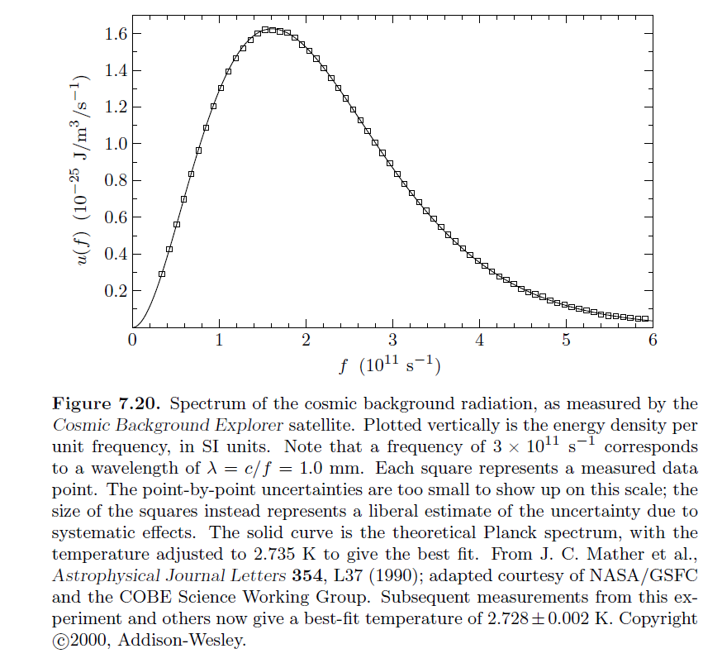
Figure from:
An Introduction to Thermal Physics, by Daniel V. Schroeder (Addison Wesley, 2000 and now Oxford University Press)
Showing frequency distribution of blackbody radiation from the big bang.

Slide 21
Big leap --
Notes:
Now consider how the EM field energy can be quantized, thinking in terms of the analogy of these equations to those of the Harmonic oscillator. We introduce a normalization factor and the creation and annihilation operators.

Slide 22
Uncontrolled energy shift
Notes:
Reviewing the commutation relations for the creation and annihilation operators. At the end, we do arrive at an expression that is very much like that of the Harmonic oscillator. However, in this case, the constant term causes trouble because it represents an uncontrolled energy. No problem. If it is unphysical, it can be strategically removed. Unfortunately, it will come back to bother us on occasion…

Slide 23
Some additional comments on the “fixed” solution --
Troublesome term
Comment: For the phonon case which served as our model, the notion of zero point motion makes physical sense. For the electromagnetic Hamiltonian the role of the equivalent concept is not quite clear (at least to me). We need to be careful when we see divergent energies to distinguish physical processes from mathematical issues.

Slide 24
Creation and annihilation operators:
Note: We are assuming that the polarization vector is real.
Notes:
With these definitions of the vector potential amplitudes, we can now write an expression for the quantum mechanical form of the vector potential.

Slide 25
Notes:
From the vector potential, we can also write expressions for the electric and magnetic fields.

Slide 26
What is the expectation value of the E field for a pure eigenstate |n> of the electromagnetic Hamiltonian?
  A complex (non zero) number
  Zero
  Infinity
What is the expectation value of the B field for a pure eigenstate |n> of the electromagnetic Hamiltonian?
  A complex (non zero) number
  Zero
  Infinity
➔In fact, these are non-trivial questions
Notes:
What do you think is going to happen?

Slide 27
At this point, we might wonder how the classical and quantum pictures of the EM field can be reconciled --
An interesting picture comes from a particular linear combination of quantum states of a single mode (kσ) arising for example in a laser

Slide 28
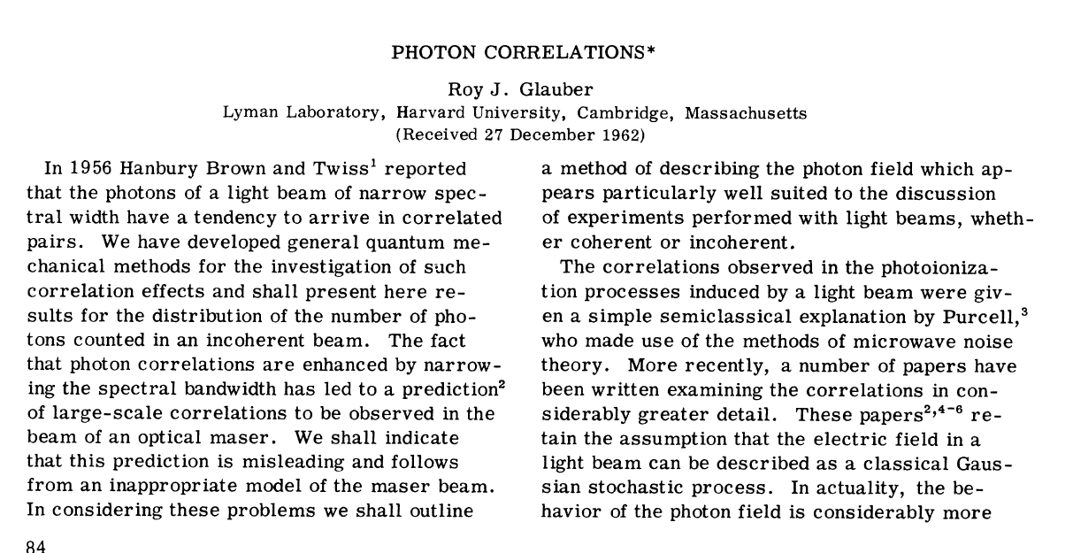
How does a quantum mechanical E or B field exist? Consider a linear combination of pure photon states --
Notes:
In this paper, the notion of a “coherent” state was introduced. As we will see, the expectation values of the electric and magnetic fields are non-zero for a system in a coherent state.

Slide 30
Summary of previous results for the electromagnetic Hamiltonian

Slide 31
Properties of the creation and annihilation operators:
Note: We are assuming that the polarization vector is real.
Notes:
Continuing review of previous results.

Slide 32
Notes:
From the quantum expression of the vector potential, we can also write expressions for the electric and magnetic fields.

Slide 33
Notes:
Consider evaluating the expectation values of these fields for a pure photon eigenstate. Embarrassingly, they are 0.

Slide 34
In order to compare the classical treatment to the quantum approach we need to calculate expectation values of the observables. In addition to mean value of an observable V, its statistical properties are also of interest, particularly the variance and the standard deviation (its square root) which is defined in terms of the average of the squared value of the observable and the average value itself:
The next few slides review the relationship of this variance to observables in quantum mechanics which have non trivial commutation relationships and thus have built in variance values.

Slide 35
Digression -- Commutator formalism in quantum mechanics
Notes:
In order to understand how the previous results can be true, we need to review the notion of variance in quantum mechanics. In particular, the variance often is controlled by non-trivial commutation relations. In this slide and the following, the relationship between variance and commutators is reviewed.

Slide 36
Proof --

Slide 38
Notes:
Wrapping up the commutator discussion with the example of the uncertainty principle applied to position and momentum.

Slide 39
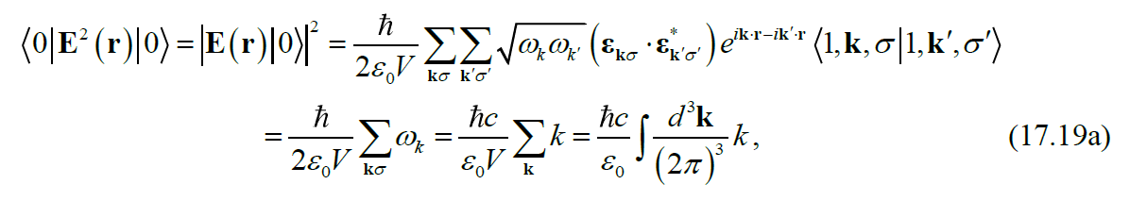
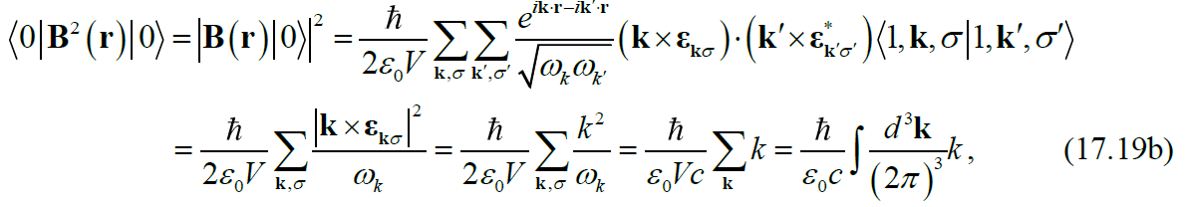
What does this have to do with quantum EM fields?
infinite
infinite
Notes:
For the E and B fields themselves, the variance is not a result of non trivial commutation relations. Here we calculate the variances for pure photon states.

Slide 40
It is also possible to show that components of the E and B field have nontrivial commutation relations, indicating that in general it is not possible to simultaneously determine E and B at the same point in space to arbitrary accuracy.
Effects of the phase of each mode.
  In deriving these equations, we neglected the phase of each mode. A more careful treatment of photon number and phase show that these also have nontrivial commutation relations.
How is this quantum treatment of the electromagnetic fields consistent with the classical picture?
  There is no need for consistency.?
  There should be consistency in certain ranges of the parameters.?
Notes:
Summary of what we have learned so far. What do you think about how the quantum equations could be related to the classical picture?

Slide 41
Notes:
Here we introduce the single mode coherent state as a particular linear combination of eigenstates of the electromagnetic Hamiltonian.

Slide 42
Single mode coherent state continued
This means that variance of the E field for the coherent state is independent of the amplitude E₀. Therefore, for large E₀ the variance is small in comparison.
Notes:
For these coherent states, we can evaluate the variance of the quantum mechanical electric field. You should verify these equations for your homework.

Slide 43
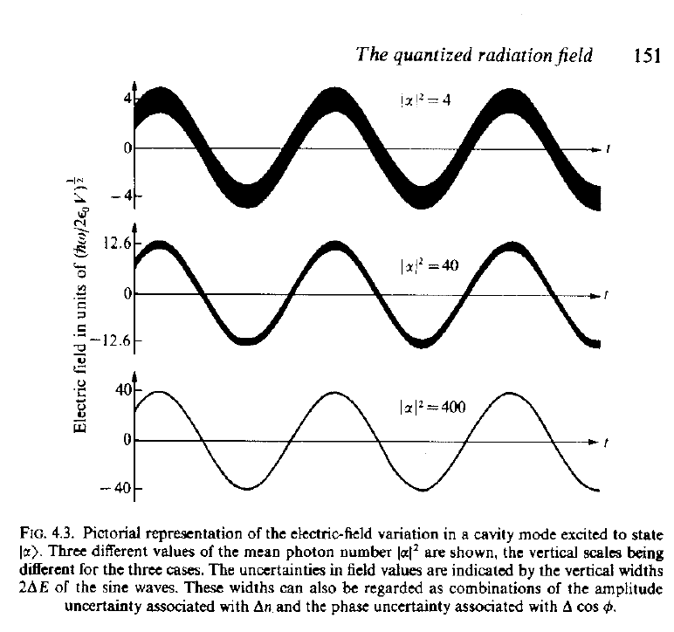
Visualization of coherent state electric fields for various amplitudes
Source: Rodney Loudon, “The Quantum Theory of Light”

Slide 44
Single mode coherent state continued
Notes:
Again using the coherent states, we can evaluate the variance of the photon number. What do you think is the significance of these results?

Slide 45
Interpretation of a single mode coherent state
Notes:
Here we see that the coherent state is related to a Poisson distribution, important in statistical analysis.

Slide 46
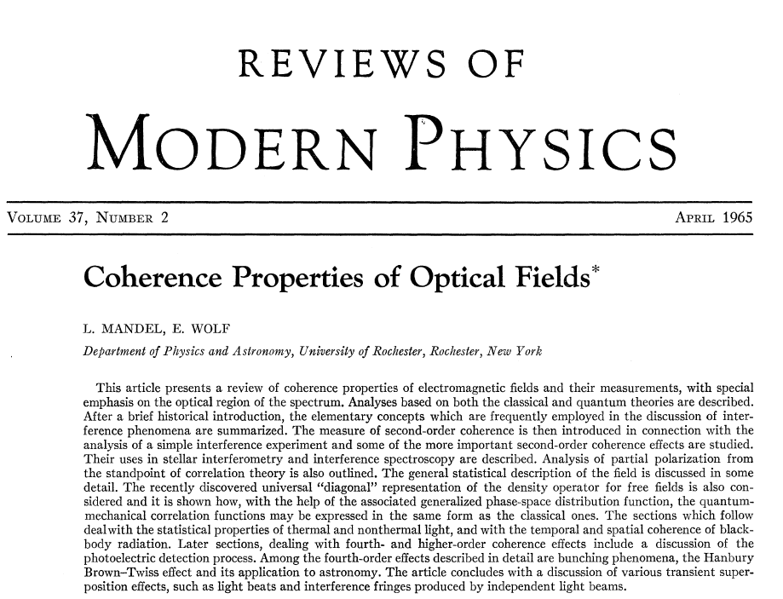
More reading -- page 231
Notes:
There are many more interesting aspects of the statistical properties of quantum electromagnetic fields. Here is an example of an interesting review article.

