Slide 1
PHY 712 Electrodynamics
10-10:50 AM MWF Olin 103
Notes for Lecture 35: Continued discussion about quantum effects in electrodynamics
Summary of pure of eigenstates of the quantum mechanical EM Hamiltonian and their properties
Various linear combinations of quantum mechanical EM eigenstates
Black body radiation
Coherent states
Squeezed states
Note that we will conclude a few minutes early so that you can
fill out the course evaluation.

Slide 2
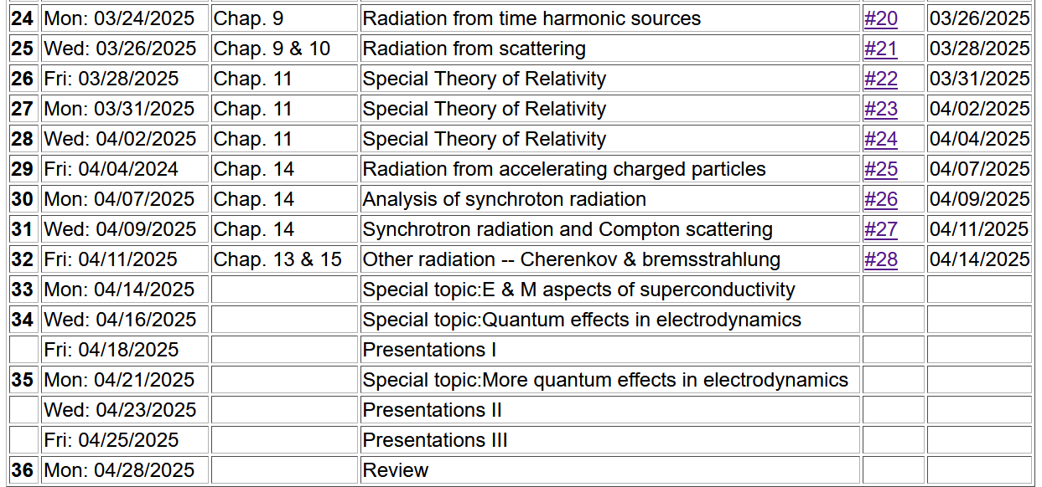

Slide 3

4 PM in Olin 101

Slide 4
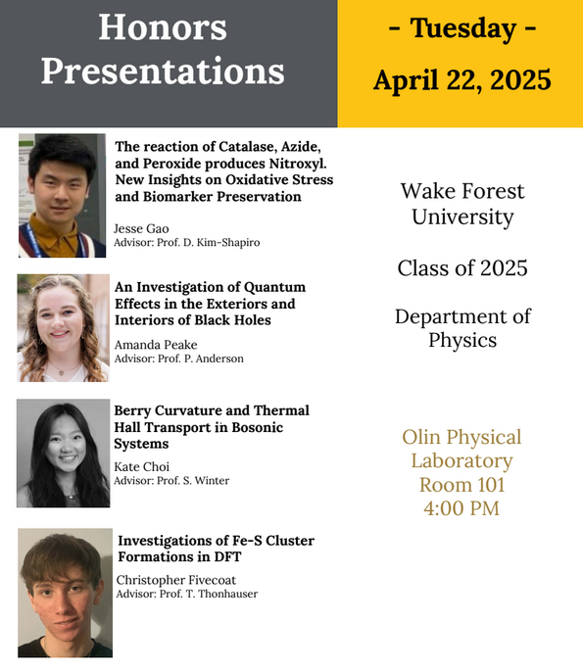

Slide 5


Slide 6


Slide 7
References for today’s lecture –
Consultation with Professor Kandada
Rodney Loudon, “The quantum theory of light” (1983)
Leonard Mandel and Emil Wolf, “Optical Coherence and Quantum Optics” (2013)
Yanhua Shih, “An Introduction to Quantum Optics” (2021) (some typos, but generally informative)
Paul R Berman and Vladimir S. Malinovsky, “Principles of Laser Spectroscopy and Quantum Optics” (2011)

Slide 8
Review of what we learned from Lecture 34
For a single mode plane wave with wave vector k, frequency
ω_{k} and polarization σ:

Slide 11
Quantum properties of electrodynamics and the properties of black body radiation (logical but not historically accurate development of the idea).

Slide 12
continuing --

Slide 13
Returning to the ideal case of a single frequency radiation mode, it turns out that lasers can output radiation very similar to that so-called “coherent state” described by R. Glauber, Physical Review 131, 2766 (1963)

Slide 16
Single mode coherent state continued
This means that variance of the E field for the coherent state is independent of the amplitude Λ. Therefore, for large Λ the variance is small in comparison.

Slide 17
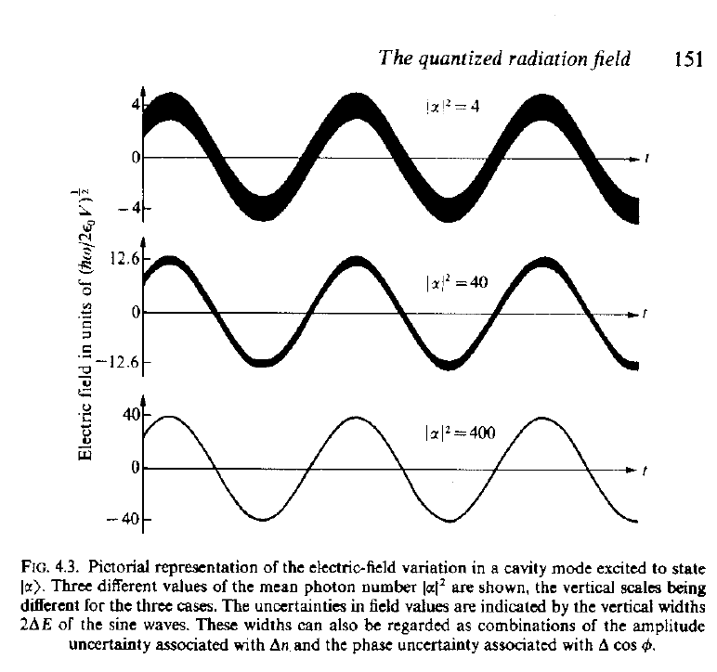
Visualization of coherent state electric fields for various amplitudes
Source:
R. Loudon, “The Quantum Theory of Light”

Slide 18
Additional properties of single mode coherent state --

Slide 19
Interpretation of a single mode coherent state

Slide 20
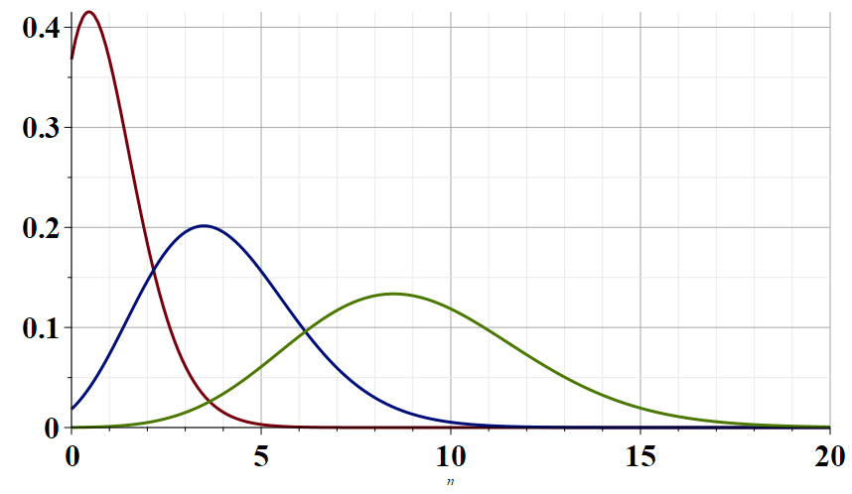
Λ=1
Λ=2
Λ=3
n

Slide 22
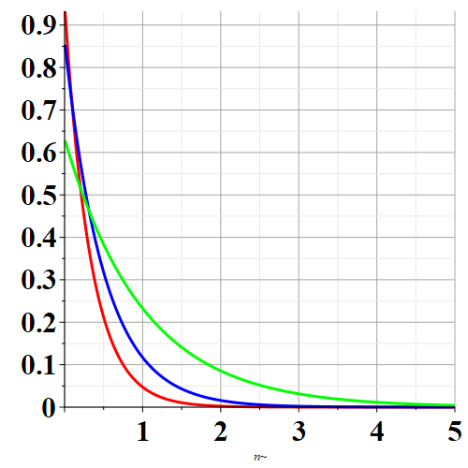
Γ = 3
P_{n}
Γ = 2
Γ = 1
n

Slide 23
Beyond the coherent state – There are problematic issues with the coherent state basis stemming from the fact that it is mathematically “over complete”.
Following Berman and Malinovsky we explore the notion of “quadrature operators” for the radiation Hamiltonian.

Slide 27
Is it possible to do better than the coherent state?

Slide 28
Review of equations related to quantized EM fields --
Note that some texts
define Q and P with
a prefactor of ½.

Slide 29
For the coherent state:
In this sense, the coherent state represents the minimum uncertainty process.

Slide 30
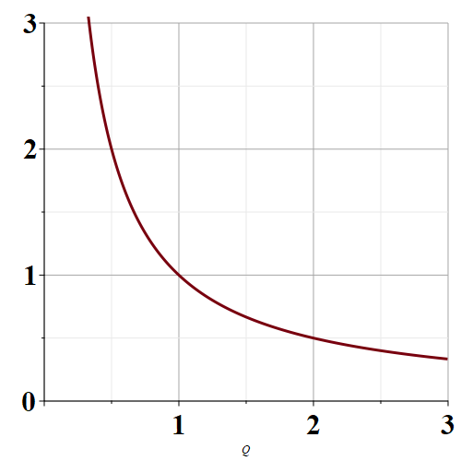
Allowed variance products
Range of values
allowed by quantum
mechanics
ΔP
ΔQ
Coherent state

Slide 31
“Squeezed” state with larger ΔP but smaller ΔQ.
Allowed variance products
Range of values
allowed by quantum
mechanics
ΔP
“Squeezed” state with smaller ΔP but larger ΔQ.
ΔQ
Coherent state

Slide 32
In terms of the eigenstates of the EM Hamiltonian:
In terms of coherent states: --

Slide 33
For the coherent state:
In this sense, the coherent state represents the minimum uncertainty process.

Slide 34
How can we transform the quadrature functions to reduce the variances of ΔQ or ΔP?

Slide 37
Evaluating the variance --

Slide 38
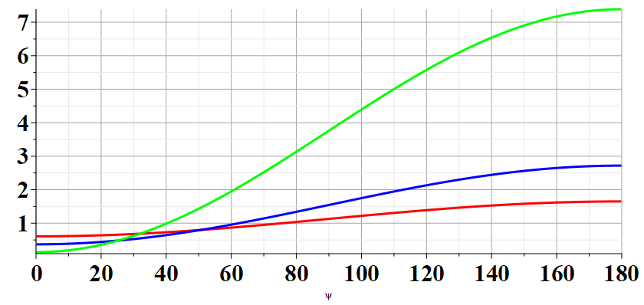
r=1.0
r=0.5
r=0.25
θ−2β

Slide 39
Searching for the best squeeze parameters
For each r, the smallest result is obtained when β=θ/2
➔Despite the constraints of the uncertainty principle, it is possible to improve the measurement of one of the two non-commuting processes.

Slide 40
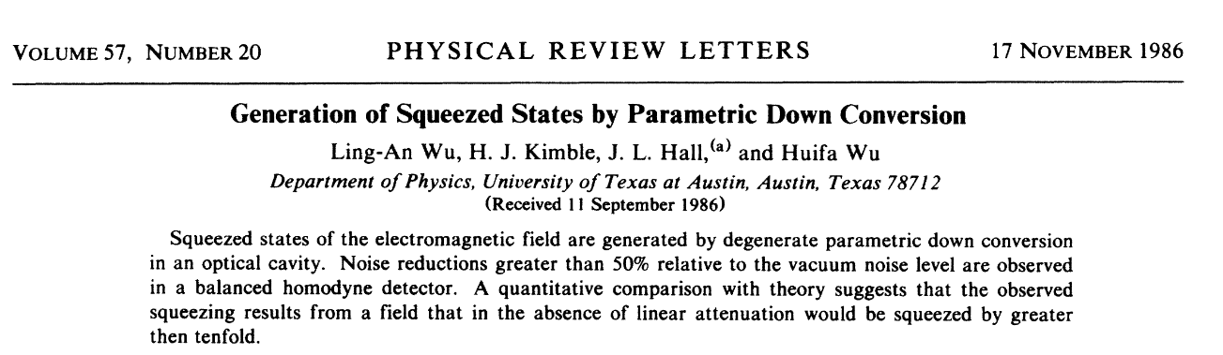
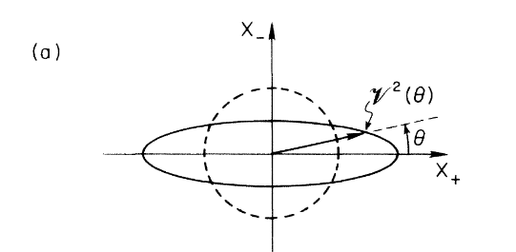
Experimental evidence
Coherent state
Squeezed state

Slide 41
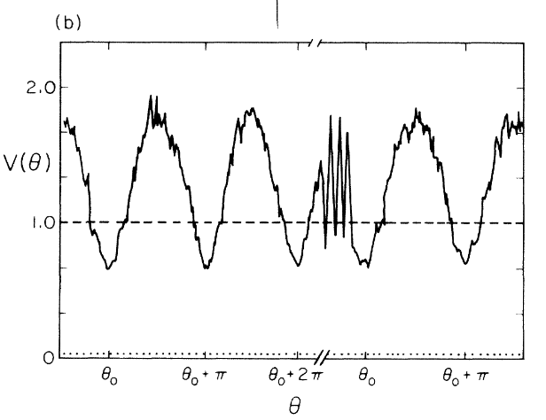

Slide 42
