Slide 1
PHY 712 Electrodynamics
10-10:50 AM MWF Olin 103
Notes for Lecture 36:
Review –
Motivation of final exam and how to optimize the experience; some comments on effective use of Maple, Mathematica
Some important mathematical tools and review of problem solving techniques
Particular electrodynamics topics

Slide 2
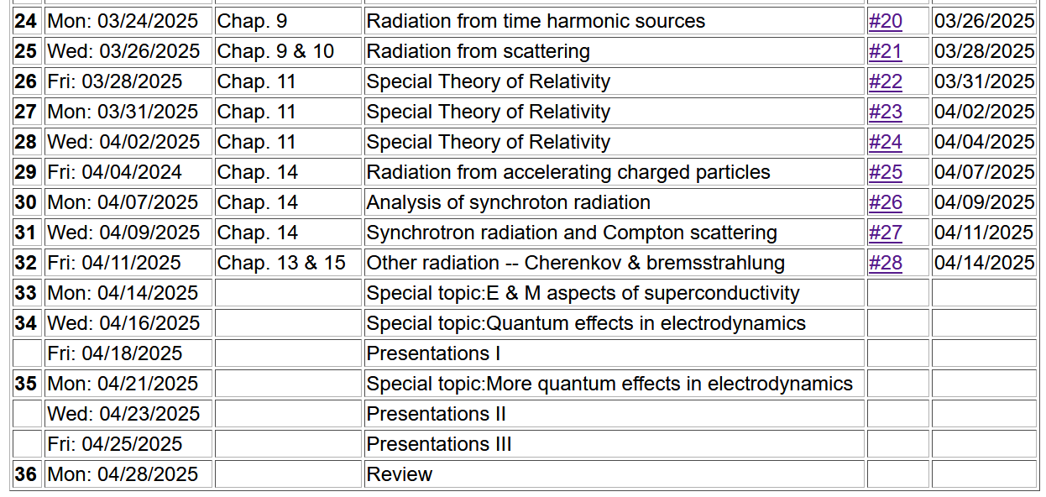
Important dates: Final exams available ~ May 2
Exams and outstanding HW due May 8

Slide 3
What will you do after May 8?
Relax a minute or two
Several of you will want to start preparing for the Qualifier Exams which will be administered (tentative dates):
Monday, June 9 to Thursday, June 12

Slide 4
Motivation for giving/taking final exam for PHY 712
Opportunity to review/solidify knowledge in the topic
Opportunity to practice problem solving techniques appropriate to the topic
Assessment of performance. Accordingly, the work you turn in must be your own (of course).
You are encouraged to consult with your instructor (but no one else!) if any questions arise about the exam questions
Extra credit awarded if you find errors/inconsistencies/ambiguities in the exam questions

Slide 5
Instructions on exam:
Note: This is a ``take-home'' exam which can be turned in any time before 5 PM Thursday, May 8, 2025. In addition to each worked problem, please attach ALL Maple (or Mathematica, Matlab, Wolfram, etc.), work sheets as well as a full list of resources used to complete these problems. It is assumed that all work on the exam is performed under the guidelines of the honor code. In particular, if you have any questions about the material, you may consult with the instructor but no one else. For grading purposes, each question in multi-part problems are worth equal weight. Credit will be assigned on the basis of both the logical steps of the solution and on the correct answer.

Slide 6
More advice about exam –
It is important that the instructor is able to read your work and understand your reasoning.
Since you will be using Maple or Mathematica or ?? to evaluate some of your results, consider integrating them into your exam paper or perhaps paste snips into your favorite word processor.
Your exam paper does not need to be a work of art, but it does need to be readable. If you prefer to submit your exam paper electronically, that will be fine. (I may print it myself.)

Slide 7
Example solution using Maple --
Text mode
Math mode

Slide 8
More advice – accumulated trusted equations/mathematical relationships and know how to use them
Jackson
pg. 783

Slide 9
Jackson pg. 783
Note that some of the “fundamental” constants change slightly over the years……

Slide 10
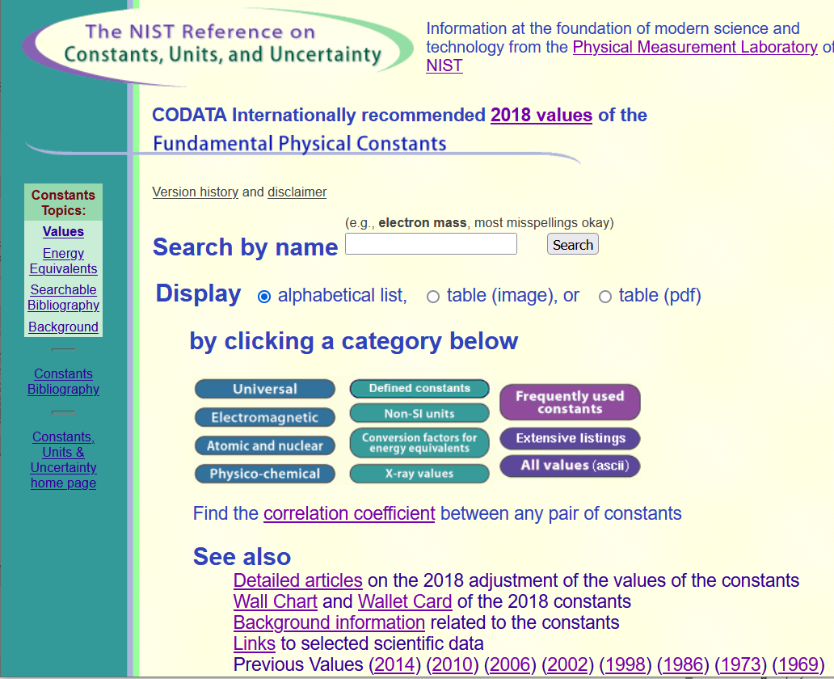
Source for standard measurements –
https://physics.nist.gov/cuu/Constants/index.html

Slide 11
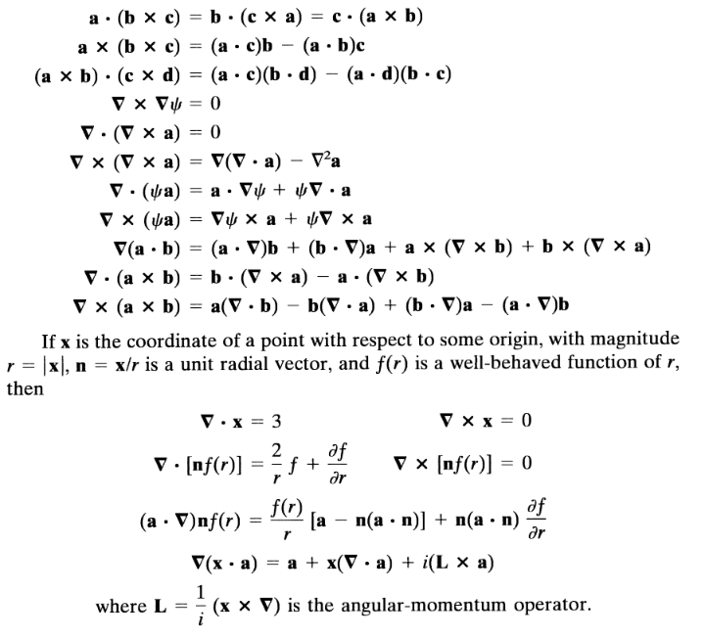
Vector relations

Slide 12
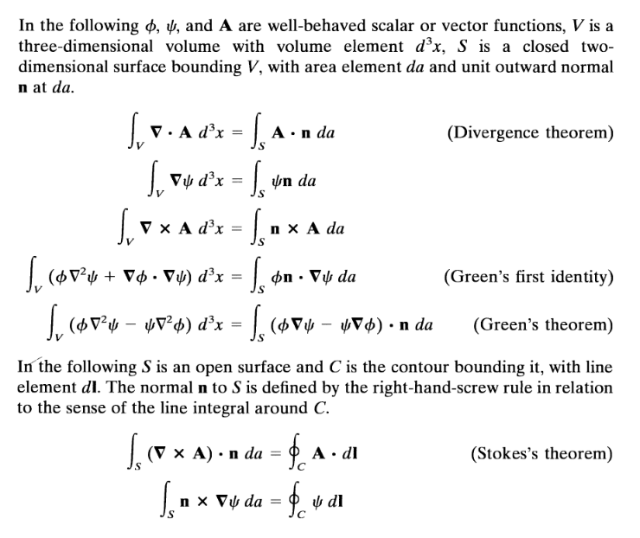

Slide 15
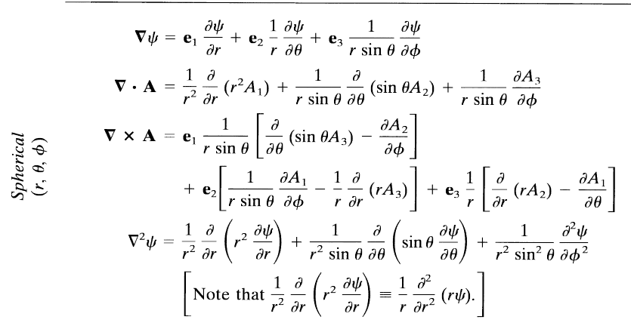

Slide 16
Comment on cartesian unit vectors versus local (cylindrical or spherical) unit vectors
Note that Cartesian unit coordinates are fixed in space, but curvilinear unit coordinates change with angle.

Slide 17
Special functions -- many are described in Jackson
Additional source -- https://dlmf.nist.gov/

Slide 19
More relationships

Slide 20
elementary charge: e=1.6021766208 x 10⁻¹⁹ C
=4.80320467299766 x 10⁻¹⁰ statC

Slide 21
Energy and power (SI units)

Slide 25
In your “bag” of tricks:
Direct (analytic or numerical) solution of differential equations
Solution by expanding in appropriate orthogonal functions
Green’s function techniques

Slide 26
How to choose most effective solution method --
In general, Green’s functions methods work well when source is contained in a finite region of space

Slide 28
Example electrostatic problem with spherical polar geometry

Slide 29
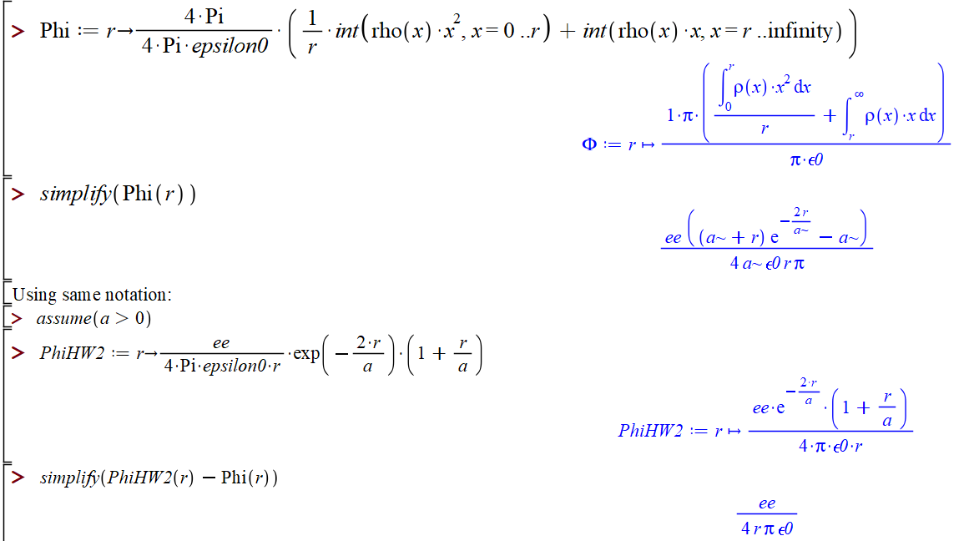

Slide 30
Electromagnetic waves from time harmonic sources

Slide 31
Electromagnetic waves from time harmonic sources – continued:

Slide 32
Electromagnetic waves from time harmonic sources – continued:

Slide 33
Electromagnetic waves from time harmonic sources – continued:

Slide 34
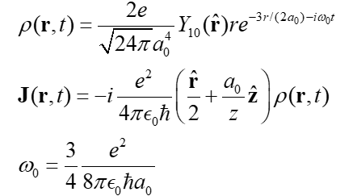
Example from HW 20
⬅ Don’t need to use this actually

Slide 35
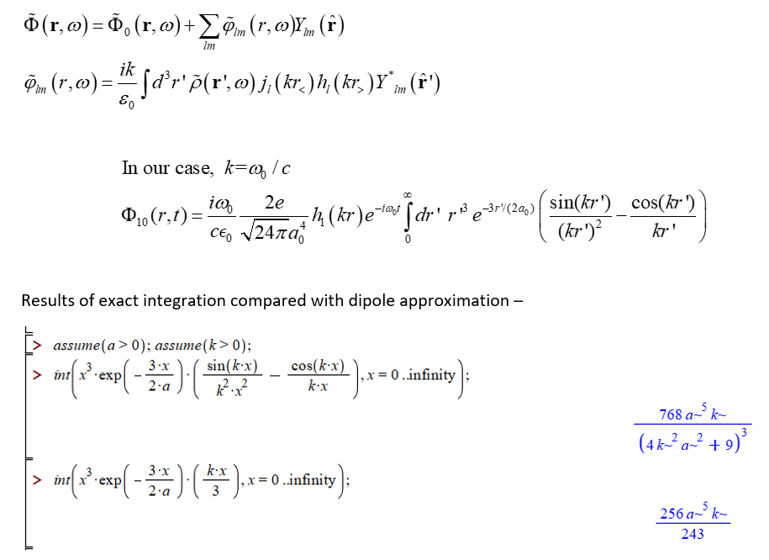
Exact
Dipole approximation

Slide 36
Results are the same when ka₀ <<1

Slide 37
Electromagnetic waves from time harmonic sources – continued:

Slide 38
Example of time harmonic radiation source
Note that this result is valid for all k.

Slide 39
Example of time harmonic radiation source -- continued
Relationship to pure dipole approximation (exact when kR➔0)

Slide 40
Electromagnetic waves from time harmonic sources – for dipole radiation --:

Slide 41
Another useful approximation for analyzing radiation for time harmonic sources --

Slide 42
Radiation from a moving charged particle
z
.
v
r-R_{q}(t_{r})=R
q
Θ
r
R_{q}(t)
y
x

Slide 43
Liènard-Wiechert potentials –(Gaussian units)

Slide 44
Electric and magnetic fields far from accelerating source:

Slide 45
Poynting vector:

Slide 46
Lorentz transformations
y
y’
v
x
x’
y’
y
x’
x

Slide 47
Note, the concept of the Lorentz transformation is quite general, but the specific transformation form given in the following slides is special to the relative velocity along the x-axis.

Slide 48
Lorentz transformations -- continued

Slide 49
Velocity relationships
➔

Slide 50
Field strength tensor
For stationary frame
For moving frame

Slide 51
➔ This analysis shows that the E and B fields must be treated as components of the field strength tensor and that in order to transform between inertial frames, we need to use the tensor transformation relationships:
Transformation of field strength tensor

Slide 52
Inverse transformation of field strength tensor

