Slide 1
PHY 712 Electrodynamics
10-10:50 AM MWF in Olin 103
Class notes for Lecture 5:
Reading: Chapter 1 - 3 in JDJ
Electrostatic potentials
One, two, and three dimensions (Cartesian coordinates)
Mean value theorem for the electrostatic potential
Notes:
In this lecture, we will continue to develop solution methods for solving electrostatic problems.

Slide 2
Notes:
Updated schedule

Slide 3
Poisson Equation
Notes:
Review of the general methods for solving the Poisson equation in various dimensions and geometries.

Slide 4
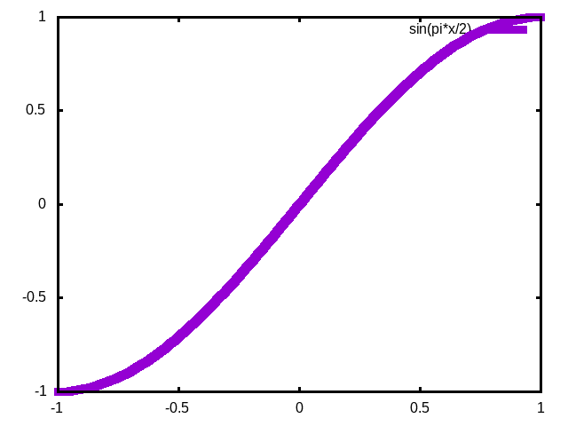
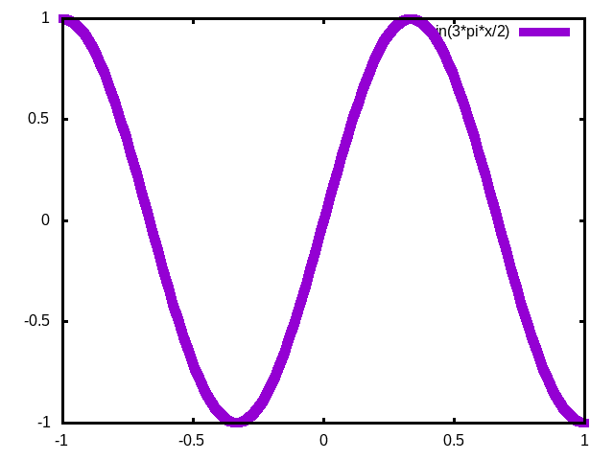
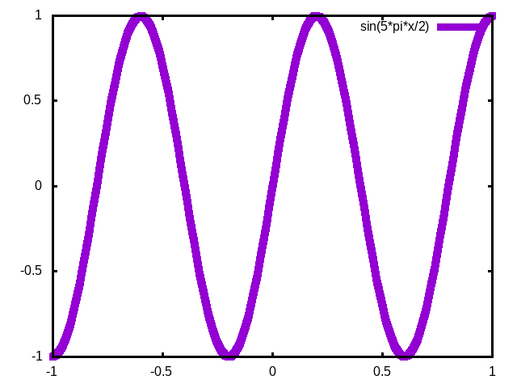
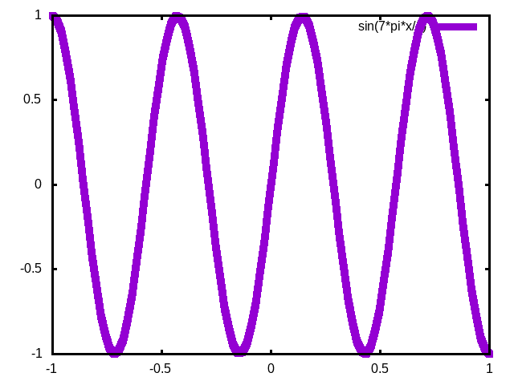
n=0 n=1 n=2 n=3
Not obviously a great choice, but we will see how it can work.

Slide 5
General procedure for constructing Green’s function for one-dimensional system using 2 independent solutions of the homogeneous equations
Beautiful method; but only works in one dimension.
Notes:
Some details

Slide 6
Notes:
Review of orthogonal function expansions.

Slide 7
Orthogonal function expansion -- continued
Notes:
Construction of Green’s function for one dimensional case.

Slide 8
Example
Note that this is a convenient choice, but not necessarily compatible with the boundary values.
Notes:
Reviewing our “favorite” example.

Slide 9
Example -- continued
Notes:
Some details.

Slide 10
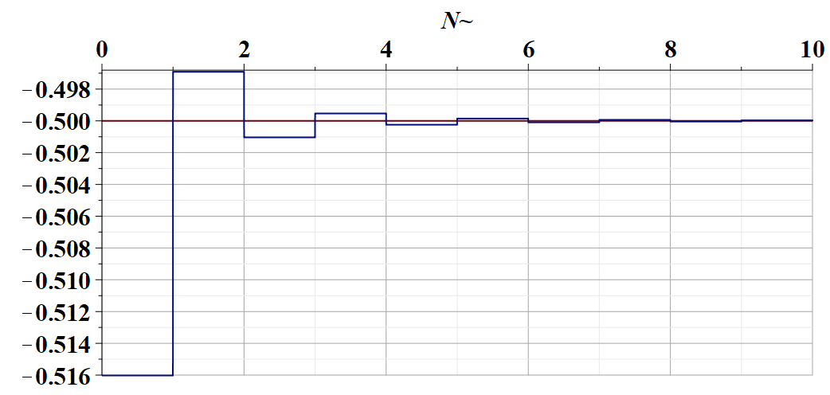
Some details --

Slide 11
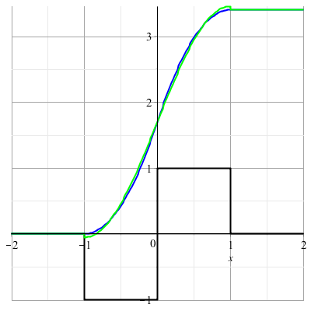
Example -- continued
Needed for boundary values.
Notes:
Summary.

Slide 12
Orthogonal function expansions in 2 and 3 dimensions – for cartesian coordinates:
(See Eq. 3.167 in Jackson for example.)
Notes:
Extension of the ideas to multiple dimensions.

Slide 13
Details of a two-dimensional example --
Example:
b
a
Two dimensional box with sides a and b with boundary conditions: Φ(0,y)=Φ(a,y)=Φ(x,0)=Φ(x,b)=0
Notes:
Analyzing in detail the two dimensional case.

Slide 14
Two dimensional example continued --
b
a
Notes:
Two dimensional case, using orthogonal functions in both x and y dimensions.

Slide 15
Example two-dimensional system continued --
Two dimensional box with sides a and b with boundary conditions: Φ(0,y)=Φ(a,y)=Φ(x,0)=Φ(x,b)=0
b
a
Don’t know this term
Know this term=0
➔In this case it is prudent to design G(r,r’) to vanishes on boundary and the surface integral is trivial.
Notes:
Specific example.

Slide 16
Note that in this case, the eigenfunctions are compatible with the given boundary values.
Notes:
Two examples.

Slide 17
Example 1 --

Slide 18
Combined orthogonal function expansion and homogeneous solution construction of Green’s function
in 2 and 3 dimensions.
For the two and three dimensional cases, we can use this technique in one of the dimensions in order to reduce the number of summation terms. These ideas are discussed in Section 3.11 of Jackson.
Notes:
Now consider using orthogonal function expansion in the x dimension and the homogeneous solution construction in the y dimension.

Slide 19
Green’s function construction -- continued
Notes:
Some details.

Slide 20
Notes:
More details.

Slide 21
Example:
b
a
Two dimensional box with sides a and b with boundary conditions: Φ(0,y)=Φ(a,y)=Φ(x,0)=Φ(x,b)=0
Don’t know this term
Know this term
Notes:
More details.

Slide 22
Example:
b
a
Two dimensional box with sides a and b with boundary conditions: Φ(0,y)=Φ(a,y)=Φ(x,0)=Φ(x,b)=0
Notes:
Checking boundary values.

Slide 23
$$,$$
Notes:
More details.

Slide 24
Green’s function construction -- continued
b
a
Notes:
Resultant effective Green’s function for this case.

Slide 25
b
a
=0
(for our case)
Notes:
Checking boundary values.

Slide 26
(somewhat painful solution to example problem)
Notes:
Application to previously discussed examples (also your homework examples).

Slide 27
Again --
A complicated expression that converges rapidly.
Notes:
Application to previously discussed examples (also your homework examples).

Slide 28
Note that up to now, we have been considering Cartesian coordinates in 1, 2, and 3 dimensions. We will need additional considerations for systems that are more naturally described in curvilinear coordinates.
➔ Additional eigenfunction expansions will be useful

Slide 29
Notes:
Changing gears slightly -- discussion of the mean value theorem for electrostatics.

Slide 30
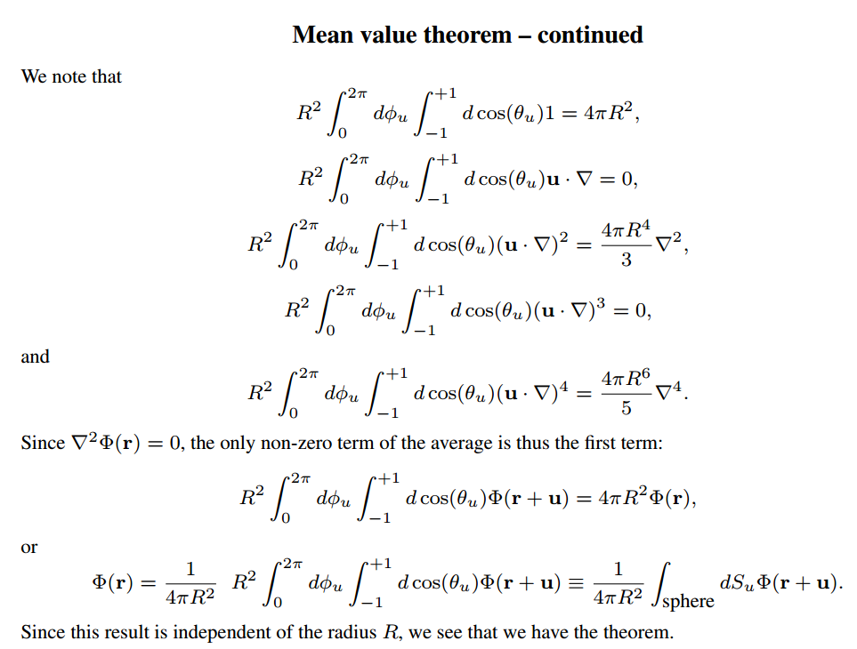
Notes:
Some details

Slide 31
Summary: Mean value theorem
Next week we will take a short digression to discuss two different “numerical” methods for solving the Poisson equation, following your textbook.
Notes:
Summary of results.

