Slide 1
PHY 712 Electrodynamics
10-10:50 AM MWF in Olin 103
Plan for Lecture 7:
    Continue reading Chapters 2 & 3
      Methods of images -- planes, spheres (JDJ Sec. 2.1-2.7)
      Solution of Poisson equation in for other geometries – cylindrical (JDJ Sec. 3.7-3.8)

Slide 2
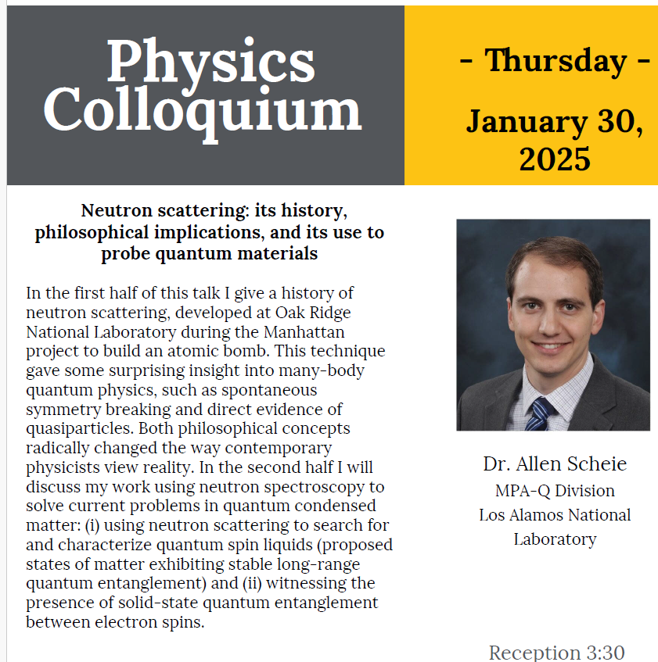
4 PM in Olin 101

Slide 3
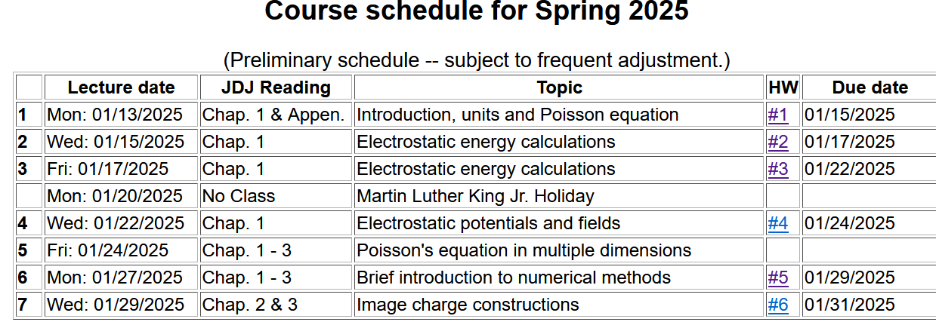
& 3

Slide 4
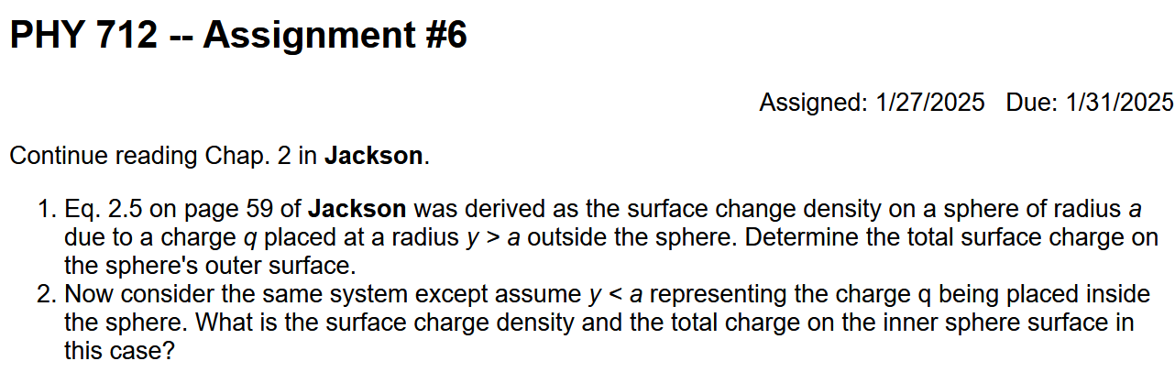

Slide 5
Survey of mathematical techniques for analyzing electrostatics – the Poisson equation
Direct solution of differential equation
Solution by means of an integral equation; Green’s function techniques
Orthogonal function expansions
Numerical methods (finite differences and finite element methods)
Method of images ⬅ today
Depends on geometry; Cartesian, spherical, and cylindrical cases considered in textbook

Slide 6

Method of images
Clever trick for specialized geometries:
    Flat plane (surface)
    Sphere
Planar case:
Consider a grounded metal sheet, a distance d from a point charge q.
q
d

Slide 7
A grounded metal sheet, a distance d from a point charge q.
Mobile charges from the “ground” respond to the force from the charge q.
z
q
d
x
y

Slide 8
Fiction
Truth
Real charges
Image charge
-q
q
d
d

Slide 9
A grounded metal sheet, a distance d from a point charge q.

Slide 10
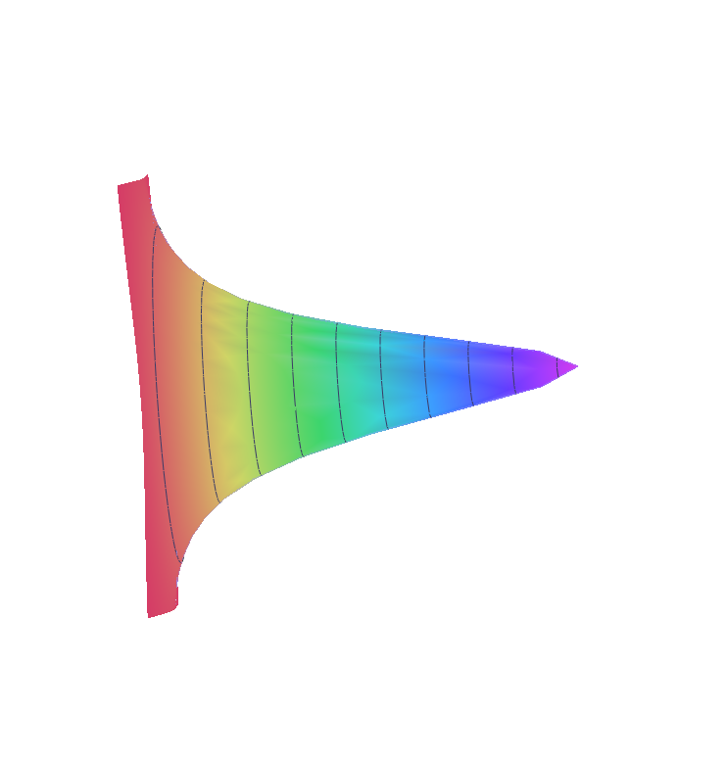
A grounded metal sheet, a distance d from a point charge q.
z
q
d
y
x=0

Slide 11
A grounded metal sheet, a distance d from a point charge q.
q
d
Note: this effect can be observed in photoemission experiments.

Slide 12
Image charge methods can be used in some other geometries --
A grounded metal sphere of radius a, in the presence of a point charge q at a distance d from its center.
r
a
d
q

Slide 13
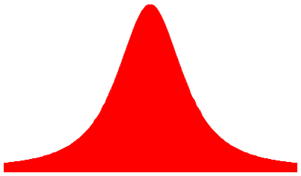
A grounded metal sphere of radius a, in the presence of a point charge q at a distance d from its center.
r
a
d
q

Slide 14
A grounded metal sphere of radius a, in the presence of a point charge q at a distance d from its center.
r
a
d
q

Slide 15
r
Comment on HW problem #6
a
d
q
(Answer to #2 should be different from that of #1.)

Slide 16
Use of image charge formalism to construct Green’s function

Slide 17
Analysis of Poisson/Laplace equation in various regular geometries
  Rectangular geometries ➔ previous lectures
  Cylindrical geometries ➔ introduce now, continue next time
  Spherical geometries ➔ following lecture

Slide 18
Solution of the Poisson/Laplace equation in various geometries -- cylindrical geometry with no z-dependence (infinitely long wire, for example):
φ
ρ

Slide 19
Solution of the Poisson/Laplace equation in various geometries -- cylindrical geometry with no z-dependence (infinitely long wire, for example):
Note that here ρ means radial coordinate
φ
ρ

Slide 20
Solution of the Poisson/Laplace equation in various geometries -- cylindrical geometry with z-dependence
φ
ρ
z

Slide 21
Cylindrical geometry continued:

Slide 22
Cylindrical geometry example:

Slide 23
Cylindrical geometry example:

Slide 24
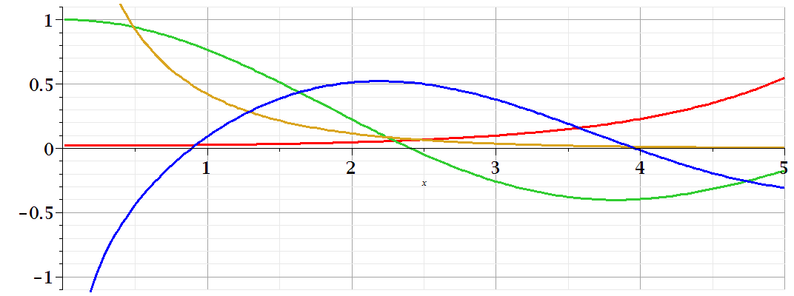
Comments on cylindrical Bessel functions
m=0
K₀
I₀/50
J₀
N₀

Slide 25
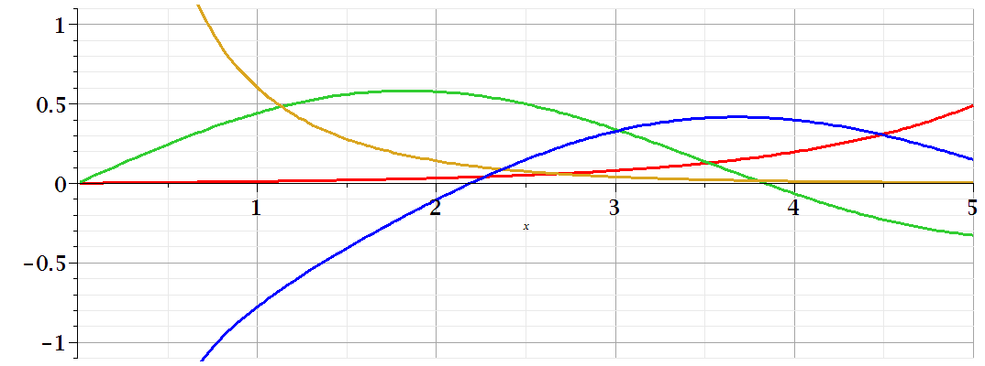
Comments on cylindrical Bessel functions
K₁
m=1
I₁/50
J₁
N₁

