Slide 1
PHY 712 Electrodynamics
10-10:50 AM MWF Olin 103
Class notes for Lecture 9:
Finish reading Chap. 3 and start Chap. 4
Solution of the Poisson and Laplace equations in spherical polar coordinates (Sec. 3.1-3.6 in JDJ)
Multipole moment expansion of electrostatic potential – (Sec. 4.1-4.2 in JDJ)
Spherical coordinates
Cartesian coordinates

Slide 2
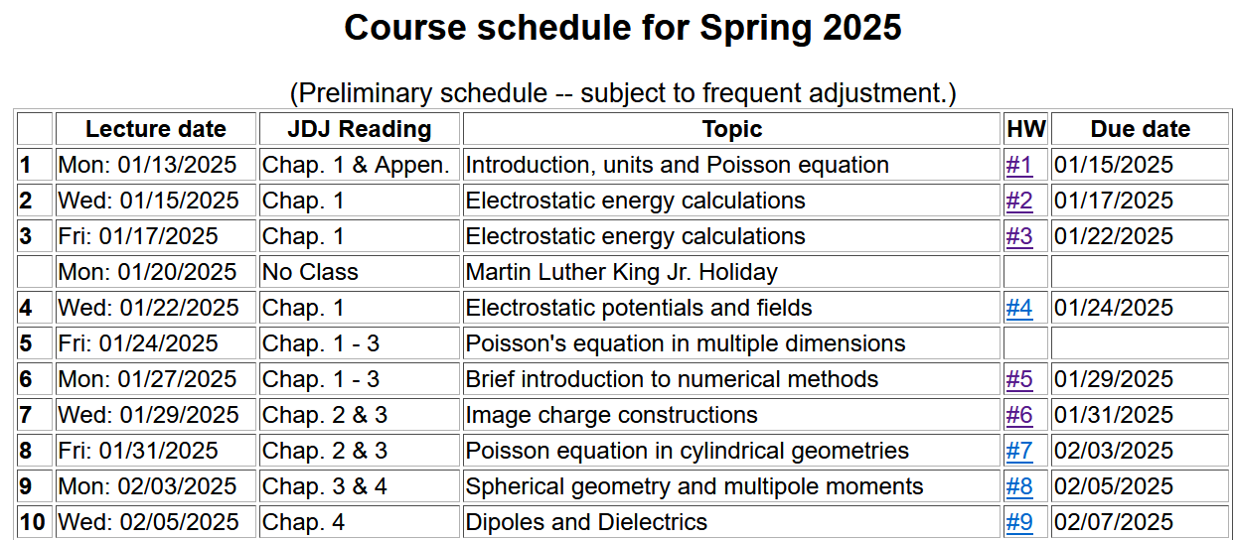

Slide 4
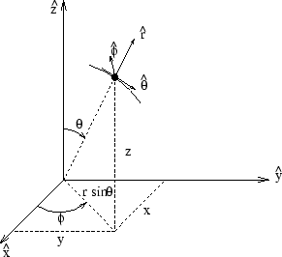
Poisson and Laplace equation in spherical polar coordinates
http://www.uic.edu/classes/eecs/eecs520/textbook/node32.html

Slide 5
Poisson and Laplace equation in spherical polar coordinates -- continued

Slide 6
Properties of spherical harmonic functions

Slide 7
Legendre and Associated Legendre functions
This is the Condon and Shortley convention and the most common.

Slide 9
Some spherical harmonic functions:

Slide 11
Some details --

Slide 12
Even more useful identity:

Slide 14
Example --

Slide 15
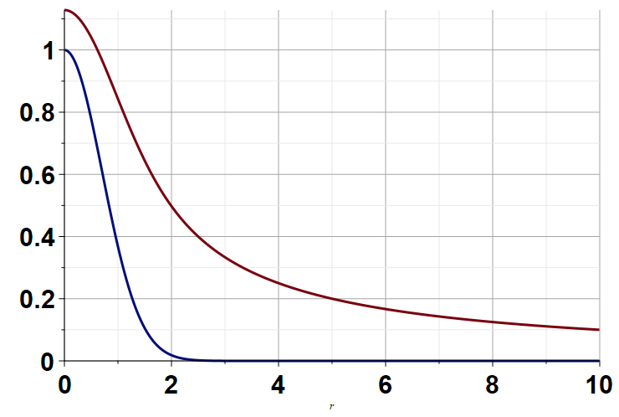
Φ(r)
ρ(r)
r

Slide 16
Another example:

Slide 17
Example -- continued:

Slide 18
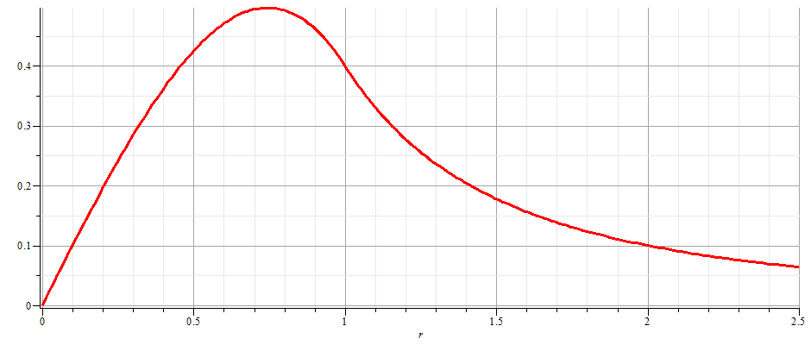
Example -- continued:
r = a

Slide 19
Notion of multipole moment:

Slide 20
Significance of multipole moments
q_{lm}

Slide 21
Multipole moments continued:
Relationship between spherical harmonic and Cartesian forms of multipole moments:

Slide 22
Consider previous example:

Slide 23
General form of electrostatic potential in terms of multipole moments:

Slide 24
Example of multipole expansion in evaluating energy of a very localized charge density ρ(r) in a electrostatic field Φ(r) (such as an nucleus in the field produced by electrons in an atom).

Slide 25
Simple examples of multipole distributions
z
+q
y
x
-q
z
+q
-2q
y
x
+q

Slide 26
Another example of multipole distribution

Slide 27
Another example of multipole distribution -- continued

Slide 28
Another example of multipole distribution -- continued

Slide 29
Another example of multipole distribution -- continued

